Slide 1
How to Reconcile your Invoice

Slide 2
To reconcile your invoice you will need access to the Itemised Prescribing Payment (IPP) Report and the Remuneration Report, both of which are located within the Information Services Portal (ISP). If you wish to see the individual drugs which have been prescribed you will need access to ePACT. ePACT is not required to reconcile your invoice.
Access to the Information Services Portal is via a secure login https://apps.nhsbsa.nhs.uk/infosystems/welcome
New users should click the ‘Register as a new user’ link and complete the registration process. Financial level access is required to complete the invoice reconciliation process.
To monitor prescribing you will need access to ePACT. Access to this system is via a registration process. Registration documents can be found at the following link http://www.epact.ppa.nhs.uk/app_help/how_to_register.htm (N3 connection required).
Access to ePACT is not required to reconcile your invoice.

Slide 3
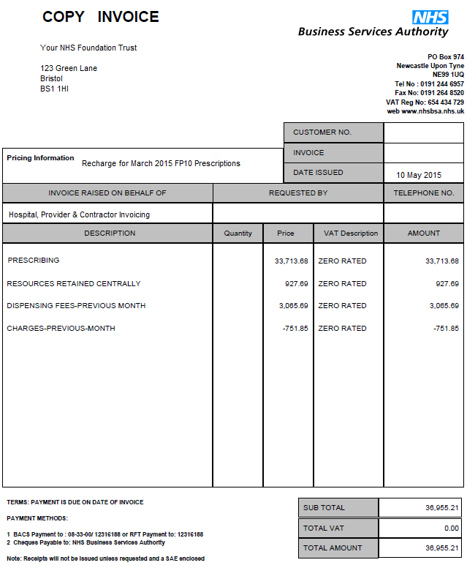
Invoice received

Slide 4
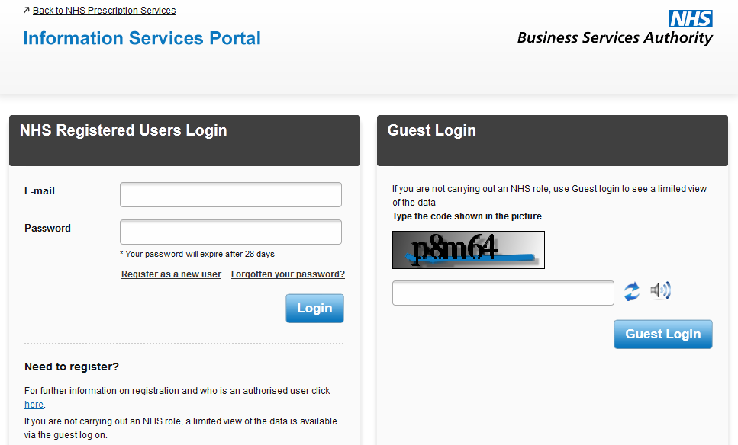
Go to the Information Services Portal and log in https://apps.nhsbsa.nhs.uk/infosystems/welcome

Slide 5
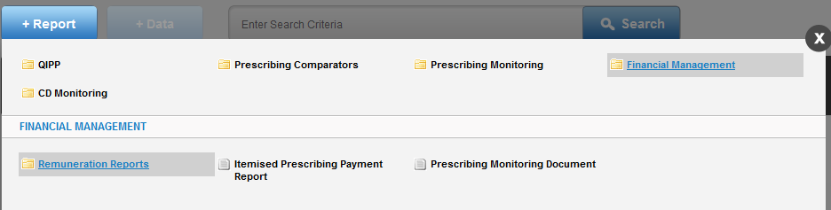
Select Itemised Prescribing Payment (IPP) Report from within Report – Financial Management (please note the report will default to the current month. If you wish to change the month shown you will need to use the ‘Data Selector’ button in the top left hand corner to make your selection. Please see user guides for further information at http://www.nhsbsa.nhs.uk/PrescriptionServices/3625.aspx).
If you cannot see the Financial Management option, this is because you do not have financial level access to the Information Services Portal. Please see the user registration page at the following link http://www.nhsbsa.nhs.uk/PrescriptionServices/3623.aspx.

Slide 6
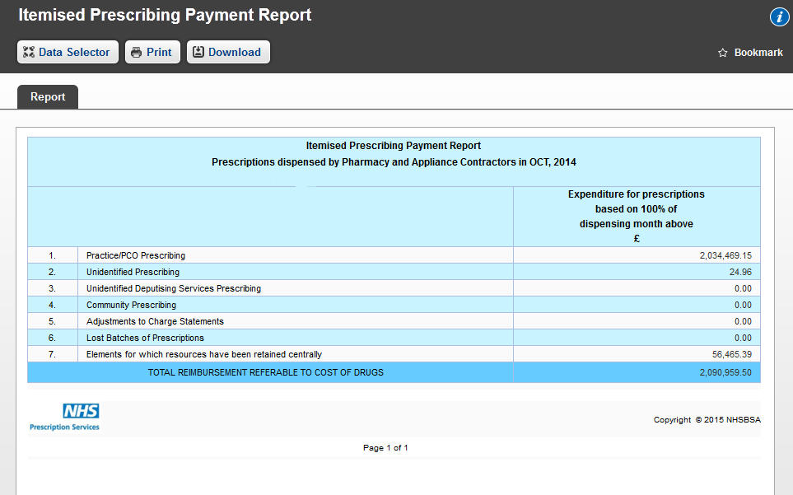
The Itemised Prescribing Payment (IPP) Report details the prescribing costs and resources retained centrally elements of the invoice.
Prescribing costs. Any unidentified prescribing will be separately invoiced. This refers to prescribing where the parent organisation has been identified, but the individual prescriber cannot be identified.
Resources Retained Centrally

Slide 7
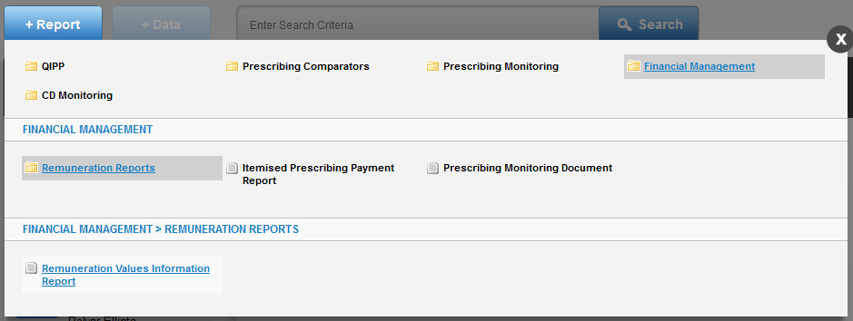
To reconcile the Dispensing Fees (previous month) and Charges (previous month), you will need the Remuneration report for the month prior to that indicated on the invoice.

Slide 8
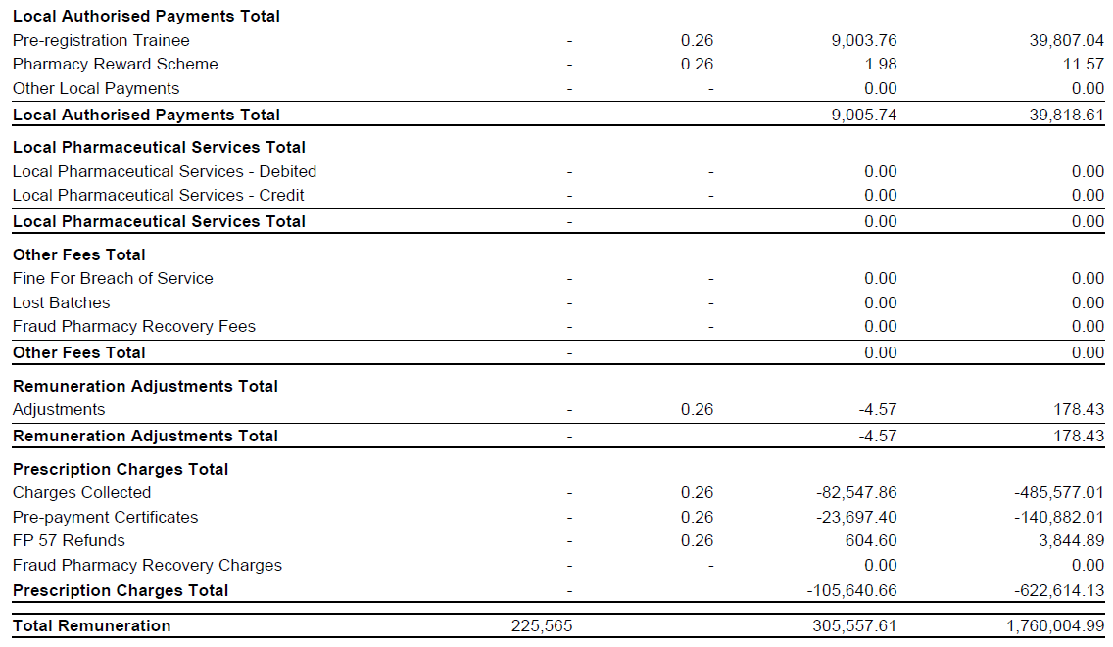
To calculate the Dispensing Fees, the Total Remuneration value should be added to the Prescription Charges Total value. Please note that due to slight differences in the way figures are rounded, you may find a small variation between the figure invoiced and the calculated figured from the Remuneration Report.
Charges – Previous Month

Slide 9
Common Queries
The dispensing fees and patient charges shown on the invoice do not
reconcile with the Remuneration Report.
Check that you are using the Remuneration Report for the correct month.
Dispensing fees and patient charges shown on the invoice relate to
the previous months Remuneration Report. Therefore the invoice for July’s prescriptions
will reconcile with June’s Remuneration Report.
Charges are shown on the Itemised Remuneration Report for
Appliance Infrastructure Payments but the provider has not prescribed
any appliances on an FP10 Prescription.
Appliance Infrastructure payments are made to appliance contractors in the
same way Establishment payments are paid to pharmacy contractors.
The cost of these payments are apportioned across all
Primary Care Organisations (PCOs) and Trusts.
The calculation used to apportion the cost is shown in the glossary at
http://www.nhsbsa.nhs.uk/PrescriptionServices/3234.aspx

Slide 10
Common Queries
I cannot access the Information Services Portal.
If you have not been set up as a Information Services Portal user please follow the instructions at
http://www.nhsbsa.nhs.uk/PrescriptionServices/3623.aspx
You will need financial access to the Information Services Portal to be able to reconcile your invoice.
If you require a password reset please click the ‘forgotten your password?’ on the following page to reset
https://apps.nhsbsa.nhs.uk/infosystems/welcome
I cannot access ePACT.
If you do not have an ePACT username or password, please complete the appropriate registration
form and follow the instructions at
http://www.epact.ppa.nhs.uk/app_help/how_to_register.htm (N3 connection required)
If you require a password reset please contact Information Services on 0191 2035050.
Please note that ePACT is not required to reconcile your invoice.

Slide 11
Common Queries
I cannot get the dispensing fees on the Remuneration Report to match
the figure on the invoice using the guidance provided. The figure is out by a small
amount (i.e. pence).
This is due to slight differences in the way figures are rounded in the Remuneration Report totals.
When using ePACT to split costs between each hospital unit, the total prescribing figure does
not add up to the amount invoiced.
The hospital invoice is now based on Actual Cost. When using ePACT to split costs between
hospital units the actual cost field should be used. Additionally, prescriptions that have been
dispensed by a GP practice should be excluded from the data as these will have
been charged to the CCG of the GP practice. To establish where a prescription has been
dispensed the dispenser code field should be included in the report.

