Slide 1
Student Services
Stakeholder Event
30/31 January 2017
NCVO, Kings Cross, London
Kerry Hemsworth

Slide 2
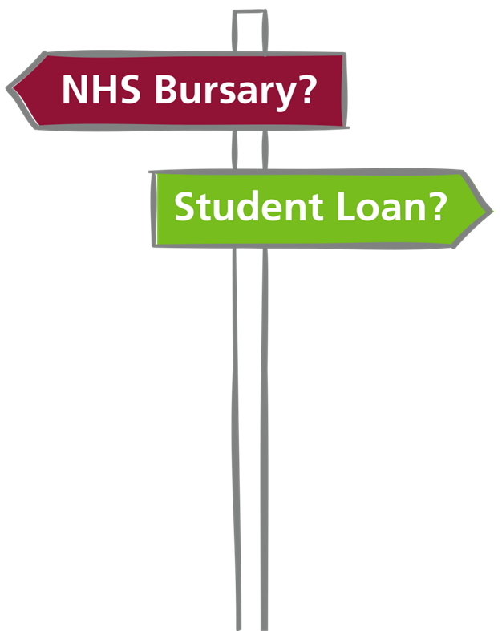
Today’s Agenda
10.00 am Refreshments
10.30 am Introduction
11.15 am Workshop Session 1
12.00 noon Workshop Session 2
12.45 pm Lunch
1.30 pm Workshop Session 3
2.15 pm Workshop Session 4
3.00 pm Q&A Session
4.00 pm Close

Slide 3
Discussions for workshops
There are four workshops taking place today. You will have been allocated a colour and this is the group you will stay in for these sessions. Each session focuses on a different topic and will look at:
Transitional arrangements
Student movement
Learning Support Fund (LSF) – Child Dependants Allowance and Travel and Dual Accommodation Expenses
Learning Support Fund (LSF) – Exceptional Support Fund

Slide 4
Housekeeping
Fire alarm
Toilets
Breaks
Please stay in the groups you’ve been allocated
Mobiles
Lunch
Question cards

Slide 5
Purpose of the day
To reiterate the details of the Health Education Funding Reforms
To provide workshops on transitional arrangements for 2017/18
To provide information and enable discussion on student deferments
To provide information on the new Learning Support Fund
To answer your questions
To provide opportunity for your input as we prepare for the 2017 student intake
Please be aware that we are still in the process of finalising the policy and procedures regarding the funding reforms. This is your opportunity to help us shape the future of student support so please get involved. More detailed information will be provided once we have taken the discussions from today into account as we finalise the work.

Slide 6
Health Education Funding Reforms

Slide 7

Consultation summary
From 1 August 2017, new nursing, midwifery and most allied health students will no longer receive NHS bursaries. Instead, they will have access to the same student loans system as other students. This applies to new students on
pre-registration courses (those which lead to registration with one of the health professional regulators).
Students who already have a degree and are planning to
undertake a nursing, midwifery or allied health profession
subject as a second degree will now also have access to
student loans through the student loans system.
This change applies only to new students

Slide 8
What is a new student?
New students are defined as starting a course:
for the first time on 1 August 2017 or later
on 1 August 2017 or later, having withdrawn from or abandoned a previous higher education course in the 2016/17 academic year or an earlier academic year
on 1 August 2017 or later, as a full time student, having transferred from a previous part-time course or full-time distance learning course which started before 1 August 2017

Slide 9
Courses affected
Nursing (adult, child, mental health, learning disability, joint nursing/social work)
Midwifery
Dietetics
Occupational therapy
Orthoptics
Orthotics and prosthetics
Physiotherapy
Podiatry/chiropody
Radiography (diagnostic and therapeutic)
Speech and language therapy
Operating department practitioner

Slide 10
Academic year 2018/19
The government will, in due course, set out arrangements for dental hygiene, dental therapy and postgraduate courses leading to registration that starts in 2018/19.
Subject to a wider consultation on part-time undergraduate maintenance loans, the plan is for new nursing, midwifery and allied health students beginning part time courses from 2018/19 onwards to apply for both tuition and maintenance loans through the Student Loans Company.

Slide 11
Counter Fraud Update

Slide 12
NHS Worker jailed for £93k false identity fraud
(August 2016)
A woman who provided false identity documents to secure work as an NHS Student Nurse has been jailed for 16 months, after a joint investigation by NHS Protect and Home Office Immigration Service.
The fraudster secured NHS employment for eight years using forged and stolen identity documents, false employment references and fake European Union (EU) documentation. The fraudster was also awarded an NHS student bursary to fund her nursing training.

Slide 13
Jailed – the ‘siblings’ who stole £558K in benefits and NHS bursaries (June 2016)
Two women who posed as sisters and lied about their identity in order to defraud the Department for Work & Pensions (DWP) and NHS of over half a million pounds have been jailed for 33 months each at Croydon Crown Court, London (Wednesday 22 June, 2016), following a joint investigation by the DWP and NHS Protect.
Collectively, the two fraudsters stole £288,153 in benefits and tax credits and £269,966 in NHS training, bursary and employment funding.

Slide 14
Into the future…
The changing role of NHSBSA Student Services

Slide 15
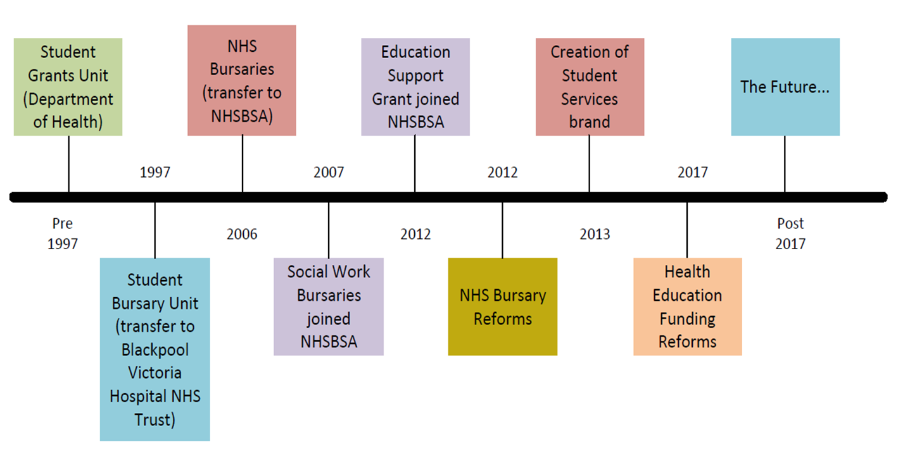
Our timeline

Slide 16
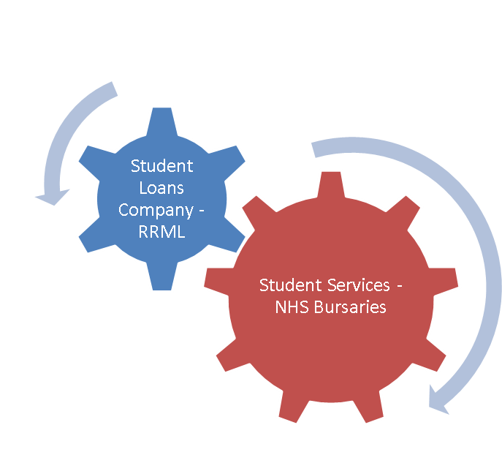
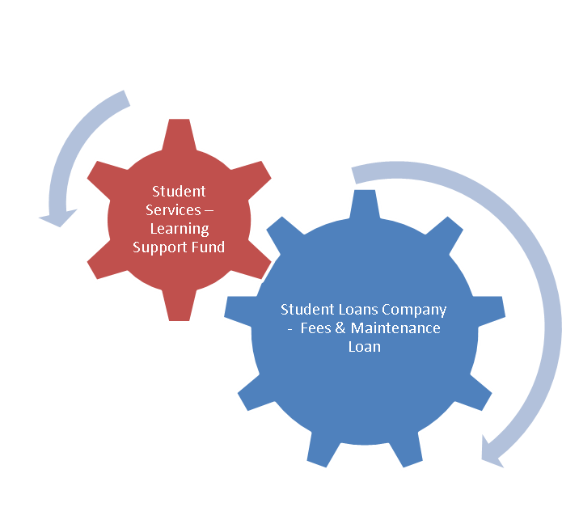
Changing customer relationship
Current
Future

Slide 17
_{STUDENT LOANS COMPANY:}
_{An introduction}
_{NHS BSA Stakeholder Event}
_{Jan 30 & 31 2017}
Charmaine Valente
Funding Information Partners Account Manager
charmaine_valente@slc.co.uk
07774 281355

Slide 18
i
SECTION CONTENTS
SLC and SFE: An Introduction
Funding Information Partners Account Manager team
SLC by the numbers
Applications
Payments to Students and Institutions
Loan Repayment
Websites, Resources and Key Contacts

Slide 19
i
STUDENT FINANCE ENGLAND
AN INTRODUCTION
Student Finance England is part of the wider Student Loans Company,
responsible for providing financial support on behalf of the UK government
to students from England entering higher education in the UK:
Depending on their circumstances, course and where they live/study,
students may be able to get a range of financial support from SFE
Generally, each academic year sees amendments to student finance policies, ranging from changes to support levels and student eligibility
rules to the introduction of new products
With this in mind it is vital that students, their parents/sponsors and the practitioners they refer to get the most accurate information possible

Slide 20

i
STUDENT FINANCE ENGLAND
SLC SUPPORT NETWORK
FI Partners
Account Mangers
Direct training and guidance for partners
HEP/FE Account
Managers
Wider SLC
Support
Telephone based support from colleagues in Glasgow and Darlington based contact centre
Practitioner support from the new Service Line
Provide on-going business to business support
Expert advice and training on using SLC systems
Guidance and support in associated functions including attendance submissions and CoCs
Focus on communicating policy, applications, repayment and resources key messages
Regional point of contact for all funding issues
Notes:
Market the course : we support with finance aspect of marketability
Learning Provider – Do it yourself (Here’s the resources)
Colleagues at your institution
Help with recruitment and their material, marketability of the courses by explaining how finance aspect of the ALL supports the overall course offer
Commentary, Common Practice
Remote Support – Mention : Open Day Support / Promotional Activity / Point of Contact for IAG / Escalation Referral Channel

Slide 21
i
STUDENT FINANCE ENGLAND
MEET THE FI PARTNERS ACCOUNT MANGERS
‘Working with partners across England and Wales, the team is responsible
for establishing/managing the relationships with admissions, outreach and
recruitment staff from across the HE and FE sectors’:
While the above is a good summary, it would take more than a few lines to cover the true extent and variety of the support we offer our partners
Our service offer is to communicate key student finance messages through bespoke Information, Advice & Guidance (IAG) training sessions and via timely remote updates
We work with contacts across SLC to help resolve long standing or complex issues surrounding policy, processes or assessments

Slide 22
i
FI PARTNERS ACCOUNT MANAGERS
TEAM MEMBERS & AREAS WE COVER
Jon
jon_legg@slc.co.uk
North West England, West Yorkshire, North Wales
Charmaine
charmaine_valente@slc.co.uk
South East England
Katy
katy_barge@slc.co.uk
South West and South Wales
Kevin
kevin_mcmullan@slc.co.uk
North East and North/South/East Yorkshire
Ahmar
ahmar_ehsan@slc.co.uk
Midlands
Ben
London and The East of England
ben_rutter@slc.co.uk
i
Full contact details: www.practitioners.slc.co.uk/fi-partner-support

Slide 23
?
SLC BY THE NUMBERS
FACTS & FIGURES

Slide 24
SLC BY THE NUMBERS
FACTS & FIGURES
Q
SLC hold and manage the personal details of how many customers?
A
7.7 million
Q
How many student finance applications do SLC process per annum?
A
1.8 million
Notes:
Hold and manage the personal details of 7.7 million customers
- therefore have an important relationship with 9.3% of the population of the UK

Slide 25
SLC BY THE NUMBERS
FACTS & FIGURES
Q
Amount paid to students in Maintenance Loans & Grants?
A
£7.1 billion
Q
Amount paid to learning providers in higher and further education?
A
£8.4 billion
Figures from SLC 2015/16 Business Plan www.slc.co.uk

Slide 26
SECTION 2
STUDENT FINANCE 2017/18
APPLICATIONS

Slide 27
STUDENT FINANCE APPLICATIONS
KEY MESSAGE – APPLY EARLY
Each year thousands of students apply late for their finance and have no
way to pay for their course or accommodation, some even have to drop out!
Please encourage the students you work with to apply on time!
It can take at least six weeks to process an application so apply early
The easiest way to apply is online at gov.uk/studentfinance*
Students don’t need a confirmed place at university or college to apply
Apply with their preferred choice, they can change details later if needed
i
*The application window is usually open from Jan-May. Students
can register on UCAS for updates and information from SFE
Notes:
EU Students still need to download and complete a paper application form!
Other notes of importance for students;
Make a note of your account log-in details and keep them safe
Agree to share information from your application, this helps apply for many bursaries and some scholarships
Make sure any evidence and information needed to support your application is supplied first time (yours and your parent/partners’)
Submit your application even if there is a delay in getting income details from your parent/sponsor so some funding (Tuition and Maintenance Loan) will be available when you start your course
If SFE ask you to send any additional evidence or documents to support your application use recorded delivery!
Before starting the application, students should have the following to hand:
• Passport - SLC can check identity using valid UK passport details for most students
• University and course details – Remember apply with your first choice initially so your application can be assessed as soon as possible
• Bank account details
• National Insurance number
• Parent’s or partner’s National Insurance number and income details

Slide 28
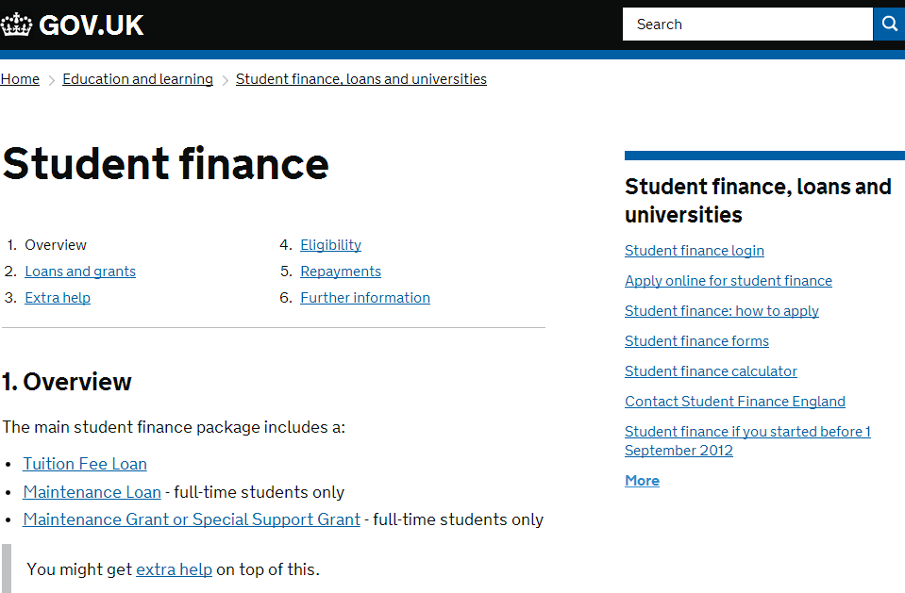
STUDENT FINANCE APPLICATIONS
GOV.UK – FOR APPLICATIONS AND INFORMATION
www.gov.uk/studentfinance
Notes:
Click image to link to page!

Slide 29
MAINTENANCE & FEE PAYMENTS
TO HEPs & STUDENTS
SECTION 2

Slide 30
TUITION FEE LOAN
LIABILITY DATES
If a student has successfully applied for a Tuition Fee Loan, Tuition Fees will be paid to a HEP at three points in the academic year
Liability Date | % of Tuition Fee Loan student will be liable for
First day of Term 1* | 25%
First day of Term 2 | 25%
First day of Term 3 | 50%
*Two weeks after Term 1 start date for part-time courses
i
Interest on the loan will be charged from the day payment is made
to the university/college, not from the liability date

Slide 31
MAINTENANCE LOAN SUPPORT
Rates for 2016 cohort F/T students, not eligible for benefits or aged over 60
Maintenance Loan paid to student in 3 instalments (figures below are total for ac yr)
Household Income | Home | Elsewhere | London
£25,000 & under | £7,097 | £8,430 | £11,002
£30,000 | £6,499 | £7,825 | £10,387
£35,000 | £5,901 | £7,220 | £9,771
£40,000 | £5,303 | £6,615 | £9,155
£45,000 | £4,705 | £6,009 | £8,539
£50,000 | £4,107 | £5,404 | £7,924
£55,000 | £3,509 | £4,799 | £7,308
£60,000 | £3,124 | £4,193 | £6,692
Notes:
Household Income Assessment
The income assessment for full year and final year rates of loans for living costs is calculated as follows:
Parental Home Rate: £1 reduction in loan for every complete £8.36 increase in income above £25,000.
London Rate: £1 reduction in loan for every complete £8.12 increase in income above £25,000.
Elsewhere Rate: £1 reduction in loan for every complete £8.26 increase in income above £25,000.
Overseas Rate: £1 reduction in loan for every complete £8.18 increase in income above £25,000.
The income threshold for the minimum non-income assessed full rate of overseas loan is: £65,797.
The income thresholds for the minimum non-income assessed final year rates of loans are: £56,835 (Home), £67,233 (London), £60,692 (Elsewhere), and £62,514 (Overseas).

Slide 32
SECTION 3
STUDENT LOAN REPAYMENTS
OVERVIEW

Slide 33
STUDENT LOAN REPAYMENTS
AN OVERVIEW
Students won’t make repayments until their future income is over
£21,000 a year gross, i.e. £404 a week or £1750 a month (before tax)
If they study a full-time course, they will be due to start repaying in
the April after graduating from/leaving higher education
They’ll repay 9% of any income over £21,000 and if employed, deductions will be made from their pay through the HMRC tax system*
If their income falls to £21,000 or below their repayments will stop
Any outstanding loan balance will be written off 30 years after entering repayment
i
*If students move or work overseas, repayments will be 9% of any
earnings over the threshold for the country they are living in
Notes:
The earnings threshold is:
£404 a week
£1,750 a month
£21,000 a year
Students who started their course before 1 September 2012 will now repay 9% of any income over £16,910 before tax per year after the April 2014 inflation increase.
Students who started their course on or after 1 September 2012 will repay 9% of any income over £21,000 before tax per year.
Overseas income assessment
If a student will be overseas for more than 3 months when in repayment, they will need to complete an Overseas Income Assessment Form to enable us to calculate how much they need to repay.
On the Overseas Income Assessment Form students should provide us with details of their circumstances and prospective income. They will also be required to provide evidence of your income or means of support.
We will then send the student a repayment schedule showing how much they need to pay each month. The monthly payments will be based upon the earnings threshold for the destination country
The repayment threshold for the UK is £21,000. So anyone with an annual salary of over £21,000 is required to repay their loan and they pay 9% of their earnings over this threshold.
If students are living overseas we work out their monthly repayment amount using the same principles as for those who live in the UK. So, they will repay 9% of earnings over the repayment threshold for the country they are living in.
To take account of differences in living costs, the repayment threshold in a foreign country may not be the same as in the UK. We will update thresholds each year to take account of price changes.
If income changes while overseas
Normally a students scheduled repayment amount is fixed for a 12 month period. However, students can apply for a reassessment of their scheduled repayment amount at any time if their income level changes.
Students can also apply for reassessment if moving between countries with different threshold bands
Students can contact us on +44 141 243 3660 to advise if they need their repayment amount reassessed.

Slide 34
STUDENT LOAN REPAYMENTS
THE FIGURES
Income each year before tax | Income from which 9% is deducted | Monthly Repayment (Approx)
£21,000 | £0 | £0
£25,000 | £4,000 | £30
£30,000 | £9,000 | £67
£35,000 | £14,000 | £105
£40,000 | £19,000 | £142
£45,000 | £24,000 | £180
£50,000 | £29,000 | £217
£60,000 | £39,000 | £292
i
For more info on repayment: www.studentloanrepayment.co.uk

Slide 35
SECTION 4
WEBSITES & RESOURCES

Slide 36
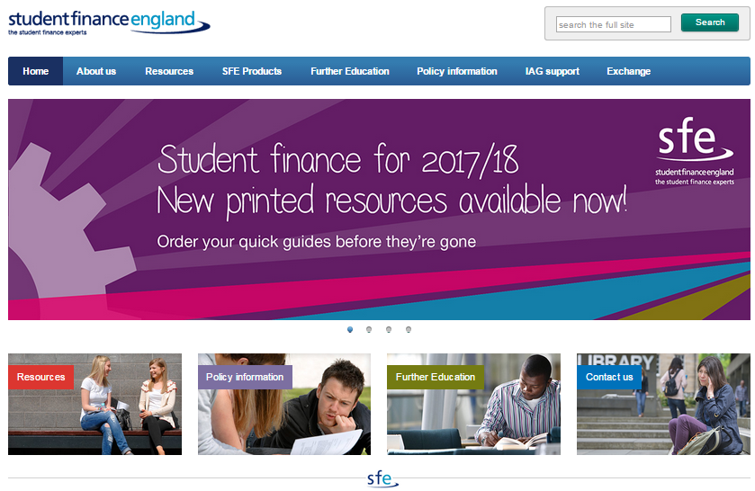
INFORMATION, ADVICE & GUIDANCE
DEDICATED SFE PRACTITIONER WEBSITE
www.practitioners.slc.co.uk
Notes:
Click image to link to page

Slide 37
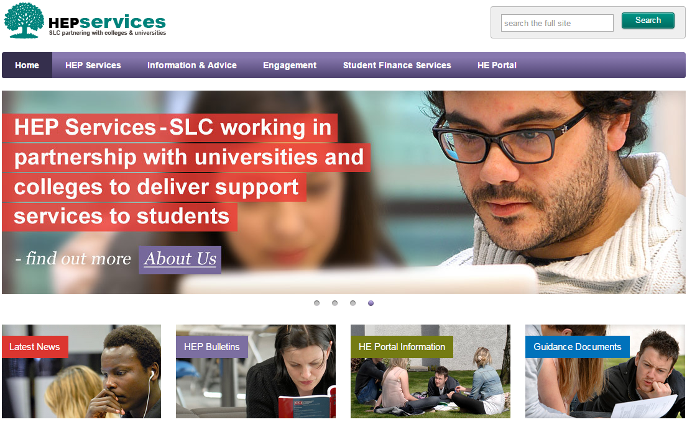
SLC ONLINE
HEP SERVICES SITE
www.heiinfo.slc.co.uk
Notes:
Click image for page link
HEP Services encompasses such processes as the collection of course information through the courses service, the administration of Bursaries, Scholarships and Fee Waivers through HEBSS (Higher Education Bursary & Scholarship Scheme) and the ongoing confirmation of registration and attendance processes.
This page is dedicated to providing Higher Education Providers with further information on all of the joint processes we operate under the banner of HEP Services. All of our HEP Services can be accessed through the HE Portal.

Slide 38
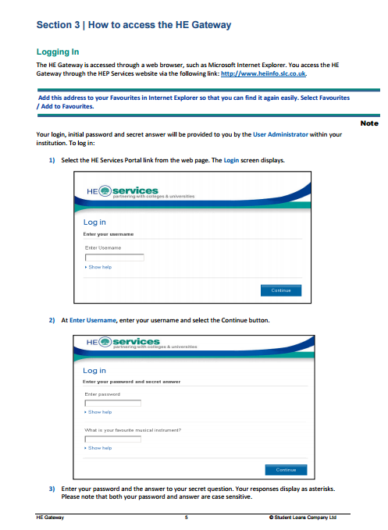
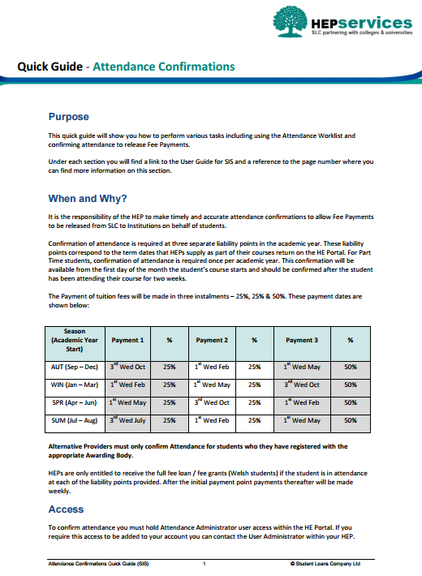
SLC ONLINE
HEP SERVICES SITE
This site gives Higher Education Providers
information on all of the processes SLC
operate under the banner of HEP Services:
Regional Support and Latest News
Information and Guidance Resources
Events and Seminars for HE Partners
Access to the HE Portal
Notes:
Click images for pages
HEP Services encompasses such processes as the collection of course information through the courses service, the administration of Bursaries, Scholarships and Fee Waivers through HEBSS (Higher Education Bursary & Scholarship Scheme) and the ongoing confirmation of registration and attendance processes.
This page is dedicated to providing Higher Education Providers with further information on all of the joint processes we operate under the banner of HEP Services. All of our HEP Services can be accessed through the HE Portal.

Slide 39




INFORMATION FOR STUDENTS
www.thestudentroom.co.uk/studentfinance
www.facebook.com/SFEngland
www.twitter.com/sf_england
www.youtube.com/SFEFILM
Notes:
Click any image to go to 16/17 resources page

Slide 40
_{QUESTIONS}
_{OR}
_{COMMENTS?}
IF YOU ARE UNSURE
PLEASE ASK!

