Slide 1
Student Services
Transitional Arrangements 2017/18
30-31 January 2017
NCVO, King’s Cross, London
Julia Smith and Kim Stephenson
Please note that we are currently in the process of finalising the policies and procedures regarding the new funding arrangements, therefore please be aware that some areas may be subject to change pending final approval

Slide 2
Introduction
Health Education Funding Reforms
2017/18 Transitional Arrangements

Slide 3
Introduction
This workshop session will cover:
  Which new healthcare students will receive NHS Bursary or equivalent maintenance bursary support in 2017/18
  What type of support will be available to each category of student
  Why funding is being extended to these students in
  2017/18

Slide 4
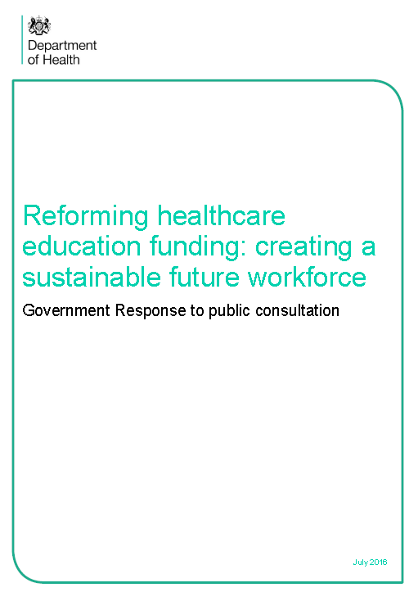
Health Education Funding Reforms (HEFR)
From 1 August 2017, the majority of new Nursing, Midwifery and Allied Health Professional (those mentioned in the reforms) students will have access to the same student loans system as all other students
However, as a response to some of the concerns raised in the HEFR public consultation in summer 2016, the government has made some exceptions for certain groups of students
These are intended as a transitional arrangement only for healthcare students starting in 2017/18

Slide 5
Which students are exempt from the changes from 1 August 2017 to 31 July 2018?
Students on certain part time courses
Dental Hygiene and Dental Therapy students
Postgraduate students

Slide 6
Students on eligible part-time courses
Maintenance bursary funding arrangements for 2017/18

Slide 7
Why will students on eligible part-time courses receive a bursary in 2017/18?
…but, for a capped number of new students on eligible part-time courses in 2017/18, a maintenance bursary will be available for the duration of their course from the NHSBSA.
Under the current student loan system, only full-time students are eligible for a loan for living costs (rules vary across the DAs)…
…but in 2017/18 this would mean that new students (domiciled in England) on pre-registration part-time courses could only get help with their tuition fees...
Subject to the outcomes of the recent consultation on part-time student support, the rules may change from 2018/19…

Slide 8
Capped places
Capped places on part-time programmes which start between 1 August 2017 and 31 July 2018 will be limited to those commissioned by Health Education England in 2016/17
Only students who take up one of the capped places will be eligible to apply for the maintenance bursary
The changes apply to England only, so the bursary places will only be available to students who are ordinarily resident in England
The places allocated specifically exclude any places that are funded on a secondment to training basis or other assisted means including self-funding

Slide 9
Capped places continued…
Students who opt to attend a full time programme on a part-time basis will not be eligible as they are not included in the capped numbers
The HEIs who have capped part-time commissioned places will shortly be notified in writing of the number of places that are applicable to them
Students that are on a full time programme but attending part-time will not be eligible for a maintenance bursary (part-time courses not students)

Slide 10
2017/18 funding arrangements for part-time students
1. Funding will be limited to a maintenance bursary only
(means tested bursary and non-means tested grant)
2. A Tuition Fee loan and DSAs will be available for these students from SLC (SFE provisions)
3…so new students on eligible part-time courses must be ordinarily resident in England
4. New students starting part–time courses after 31 July 2018, subject to wider consultation, will be able to access a maintenance loan from SLC
5…but the NHSBSA will retain the 2017/18 p/t intake(s) for the duration of their course, providing there are no changes to attendance

Slide 11
Eligibility criteria
Students must be enrolled on an eligible part-time course and awarded a capped NHS Bursary place by their HEI
Students must be ordinarily resident in England on the first day of the 2017/18 academic year, rather than the wider UK
Students will be subject to the usual eligibility criteria regarding residency
Applied for and in receipt of tuition fee support from SLC
EU ‘Fees Only’ students are not eligible

Slide 12
Changes in course attendance
If a student defers their offer of a training place on a part-time course commencing after 1 August 2017 they may not be eligible for a maintenance bursary from NHSBSA
From 1 August 2018 it is the intention that, subject to outcomes from the recent consultation, part time students will be able to receive a maintenance loan through the Student Loans Company (SLC)
Where a student enrols on a part-time course commencing on or after 1 August 2017 but subsequently withdraws or temporarily suspends their studies regardless of the reason and later returns, they may not be eligible for any bursary funding elements
Where a student who is eligible for a bursary maintenance award and subsequently transfers to a full time course at the same or different HEI, they will no longer be eligible for any bursary
If a student subsequently transfers back to part-time they will not be eligible for any bursary award

Slide 13
Postgraduate, Dental Therapy and
Dental Hygiene Students
NHS Bursary funding for 2017/18

Slide 14

Arrangements for Postgraduate (PG), Dental Hygiene (DH) and Dental Therapy (DT) students in 2017/18?
For 2017/18, Health Education England (HEE) will commission the programmes and the NHS Bursary will be available through the current arrangements in place
HEE will be notifying HEIs of places through the standard commissioning arrangements.
Applies to all new PG, DT and DH students starting between 1 August 2017 and 31 July 2018, so….
Notes:
For those commencing studies during the period 1 August 2017 to 31 July 2018
Current bursary arrangements for PG courses to continue in 2017/18
Students will receive a maintenance bursary and Fees as previously
PG Programmes will be commissioned through HEE
Transitional arrangement only until PG courses fit the standard funding model for SFE support

Slide 15

Future funding
This is a transitional arrangement only for new Postgraduate (PG) and Dental Hygiene/Dental Therapy (DH/DT) students commencing studies during the period 1 August 2017 to 31 July 2018.
The government will, in due course, set out arrangements for dental hygiene, dental therapy and postgraduate courses leading to registration that starts in 2018/19.
The NHSBSA will administer NHS Bursaries for the duration of their PG, DT or DH course, providing there are no changes to attendance.
Notes:
New students expected to be funded via SLC

Slide 16

Any questions?

