Slide 1
Student Services
Welcome to the NHSBSA Student Services Stakeholder Event
30 and 31 January 2017
NCVO, King’s Cross, London

Slide 2
Today’s Agenda
NCVO, 8 All Saints St, London N1 9RL
10.00 am Refreshments
10.30 am Introduction
11.15 am Workshop Session 1
12.00 noon Workshop Session 2
12.45 pm Lunch
1.30 pm Workshop Session 3
2.15 pm Workshop Session 4
3.00 pm Q&A Session
4.00 pm Close
Note: During lunchtime and between 4pm and 5pm Student Services Staff will be available to discuss any personal queries you may have about Student Services operations.

Slide 3
About us
We are responsible for administering and paying bursaries to healthcare and social work students.
We cover four areas:
NHS Student Bursaries (including funding reform transitional arrangements for 2017/18)
Social Work Bursaries
Education Support Grant (ESG)
Learning Support Fund (LSF)
You can find more information about us and the work we do on our website
www.nhsbsa.nhs.uk/students

Slide 4
In 2015/16 we delivered this activity:

Slide 5
Bursary Reforms
Following the government announcement to reform health education funding, the way we work will be changing. New students on full time Nursing, Midwifery and some Allied Health Professional courses (those included in the reforms) starting on or after 1 August 2017 will come under the new rules.
We are working with the Department of Health and other delivery partners to finalise the operational detail for this.
NHSBSA will be administering the transitional arrangements for 2017/18 and the new Learning Support Fund which will cover three main areas:
Child Dependants Allowance
Travel and Dual Accommodation Expenses
Exceptional Support Fund

Slide 6
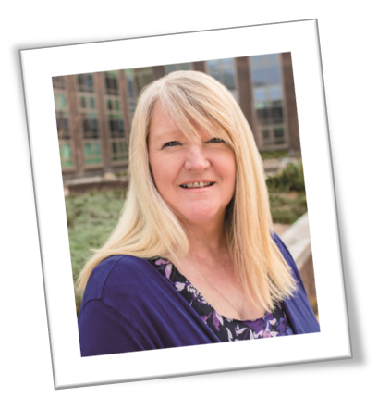
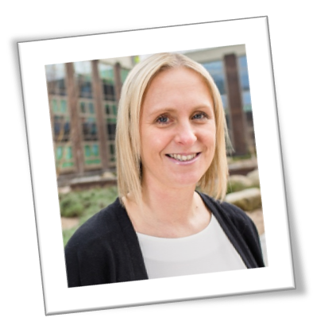
Meet our team
Kerry Hemsworth
Head of Student Services
Louisa Ruman
Student Services Manager

Slide 7
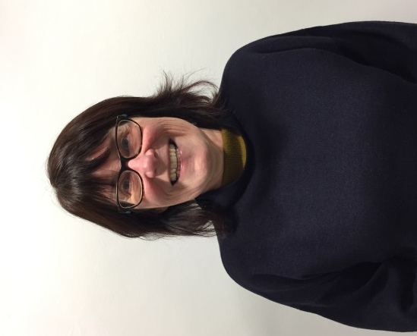
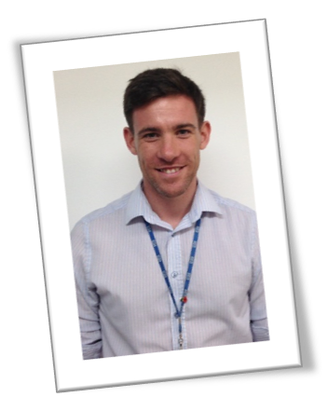
Julia Smith
Policy Advisor
Kim Stephenson
Policy Advisor
Matt Rainbow
Technical Services Manager

Slide 8
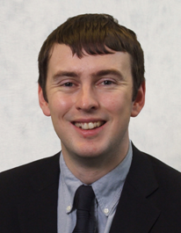
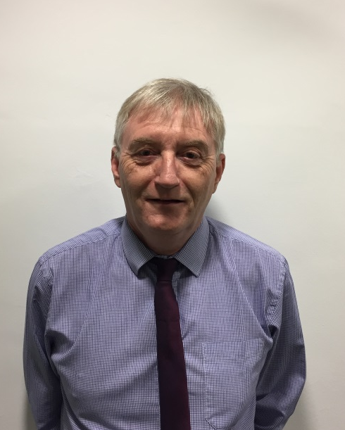
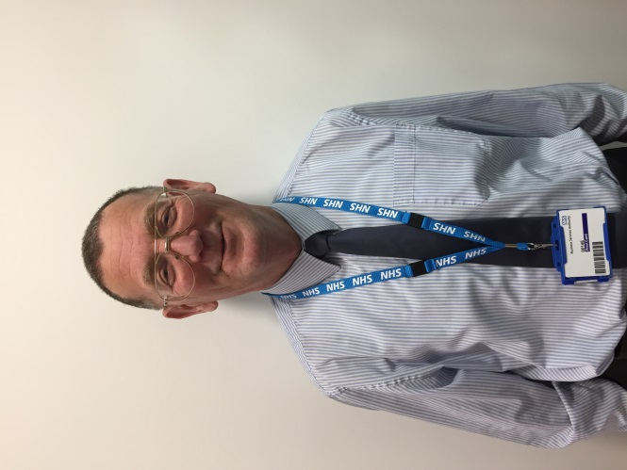
James Davenport
Senior Communications Manager
Michael Durnan
Service Improvement Manager
John McComish
Stakeholder Support Officer

Slide 9
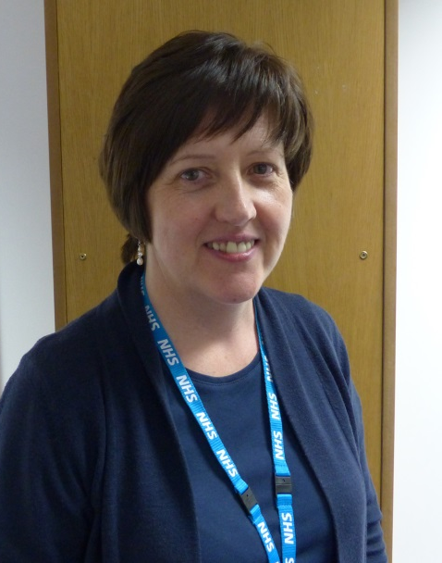
Darren Hanson
Training Co-ordinator
Alison Porter
Funding Reforms Implementation Manager
Simon Wall
Service Delivery Manager
Contact Centre Services

Slide 10
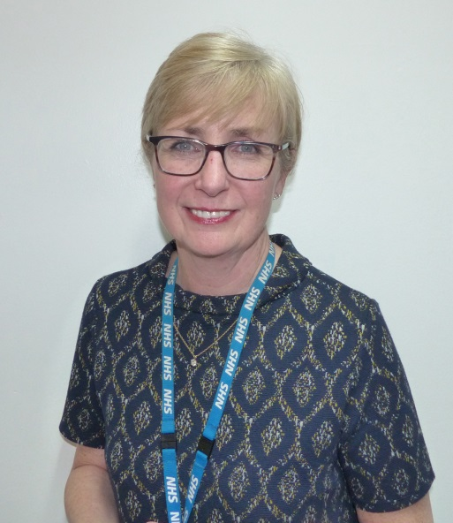
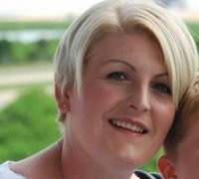
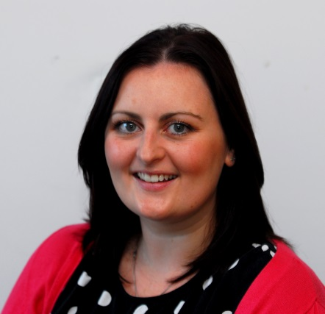
Joanne Twissell
Executive Assistant
Hollie Edminson
Team Manager
Contact Centre Services
Sarah Regan
Communications Officer

Slide 11
Did You Know…
In 2015/16 we dealt with 260,265 customer calls
In 2015/16 we responded to 10,803 enquiries
386,041 customers accessed our information on Ask Us, our customer self-serve application
In 2015/16 we scanned 209,123 documents
Our complaints have reduced by 76% since 2012

Slide 12
Find us on social media!
Follow us on Twitter and join in the conversation with over 2,900 followers @NHSBSA_Students
Like us on Facebook and join in with over 47,000 people across our two pages to keep up to date with all the latest information regarding student services:
/NHSstudentbursaries
/socialworkbursaries

