Slide 1

Quality, Safety and Value
An Overview of the NHS Clinical Evaluation Team
David Newton
Clinical Specialist Lead, NHS CET
6th January 2017
Notes:
Welcome to Department of Health and this presentation about the NHS CET.
HOUSEKEEPING. FIRE ALARM – Test ?
Intermittent – Prepare to Leave
Constant – Vacate and Meet at the Assembly Point which is displayed on the back of your Visitor Pass

Slide 2
‘Quality, safety and value are at the heart of our work and it’s important that we use our clinical experience to deliver high standards of care while reducing cost and waste in the NHS.’
Mandie Sunderland
Chair, Clinical Reference Board
(Governing body of the NHS Clinical Evaluation Team)

Slide 3
Agenda for today
To provide an overview of the NHS Clinical Evaluation Team work plan and process
To inform when suppliers can engage in the CET Process
Confirm what information & evidence the NHS CET are requesting and why
How to find more information and initial reports
Opportunity for conversation

Slide 4
NHS Clinical Evaluation Team - A national team to support the delivery of quality clinical products to frontline staff
To support efforts to deliver to the NHS high quality everyday healthcare products that meets an NHS defined requirements sourced on a national scale.
To make it as easy as possible for frontline NHS staff to pick the right product for safe, effective patient care every time they need to.

Slide 5
NHS Clinical Evaluation Team members
Name | Role | Name | Role
Dr Naomi Chapman (Clinical Lead) | Executive Nurse Network Lead Royal College of Nursing | Simon Hall | Tissue Viability Lead Nurse, University Hospitals Bristol
Liam Horkan | Clinical Procurement Specialist, Colchester Hospital University NHS Foundation Trust | Sian Fumarola | Senior Clinical Nurse Specialist Tissue Viability and Continence, University Hospitals of North Midlands NHS Trust
David Newton | Matron-Clinical Procurement, Nottingham University Hospitals NHS Trust | Jill Best | Queens Nurse - District Nurse South Tees Hospital NHS Foundation Trust
Stephanie McCarthy | Clinical Procurement Nurse, Royal Derby Hospital | Marc Naughton | Paramedic / Assistant Operations Manager, North West Ambulance Service
Notes:
This slide shows the members of the Clinical Evaluation Team. The team includes representation from across the country, acute and community and the royal College of Nursing.
Members have a range of specialisms which will be matched with the different categories of activity being planned.

Slide 6
Clinical Evaluation Team – Where we fit in the landscape
Department of Health
NHS Clinical Evaluation Team
NHS Customer Board
Business Services Authority
Clinical Reference Board
Regional Boards
NHS Supply Chain

Slide 7
Clinical Reference Board Objectives
Raise awareness of and champion the role clinicians play in achieving high quality and best value from clinical products
Establish and effectively govern the NHS Clinical Evaluation Team
Pilot projects which promote standardisation and safety and reduce wastage across the NHS
Support implementation of national policy including Lord Carter’s recommendations

Slide 8
Why do we need to make changes?
Quality - Evidence suggests that nursing and midwifery involvement in purchasing of clinical products improves quality and patient experience. | Wastage - Waste in relation to clinical products is putting increasing pressure on the NHS.
Value - All trusts are under pressure to make savings. We must work together to protect patient safety and the frontline as a priority. Every £30,000 saved equates to one Band 5 nurse. | Efficiency - If we can buy products more effectively across the NHS then there is less need to look for efficiencies at the bedside.

Slide 9

Taking local learning to a national level

Slide 10
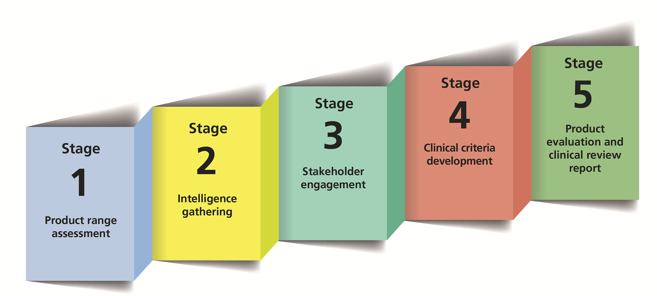
NHS Clinical Evaluation Team Clinical Pathway

Slide 11
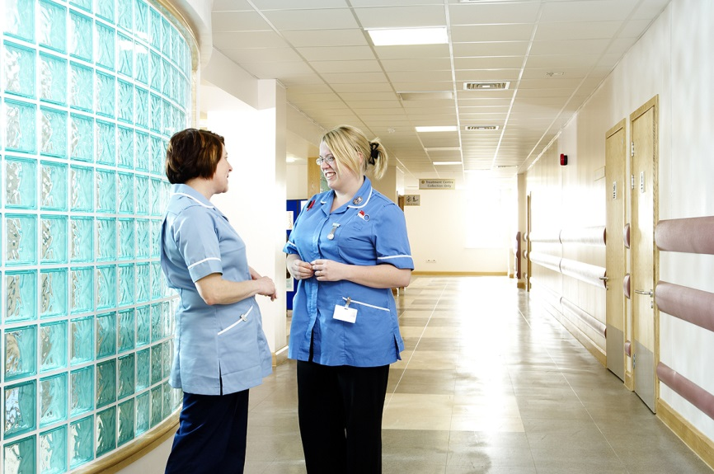
Everyday healthcare consumables
Everyday healthcare consumables are products that are found in the majority of wards, clinics, health centres, treatment rooms and district nurses’ bags across the NHS.
Patient Impact
Staff Impact
High Volume

Slide 12
NHS Clinical Evaluation Team Clinical Pathway
Supplier Evidence Request

Slide 13
NHS Evidence & Information
Confirmation of product testing information including British and international standards
Research or clinical usage evidence that supports the quality of your devices in the delivery of safe patient care
COSHH data sheets and/or technical information
Any additional information to support your product in use (e.g. productivity, efficiency, innovation)

Slide 14
NHS Clinical Evaluation Team Clinical Pathway

Slide 15










Clinical Conversations
Engagement days
Focused visits
Leeds
Clinical events, forums & networks
Nuneaton
London
Plymouth
Notes:
Engagement was vital to ensure all perspectives had been included and no bias to north / south etc

Slide 16
Wider healthcare conversations
  National Institute of Health and Clinical Excellence
  National Institute of Healthcare Research
  The Patients Association
  MHRA
  Royal Colleges, societies & charities
  Industry bodies
  Getting It Right First Time – (DH)
  Clinical Procurement Specialist Network
  Regional Tissue Viability Networks

Slide 17
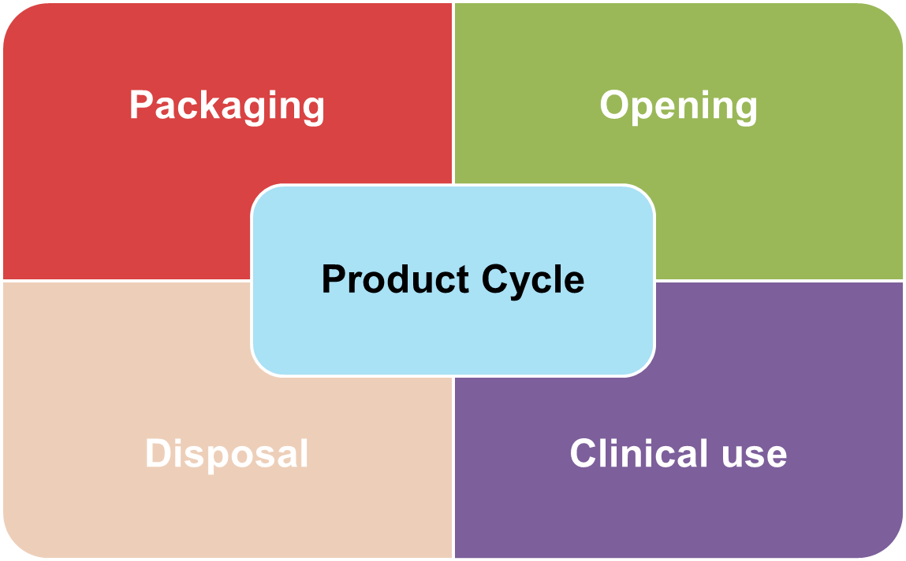
Developing Clinical Criteria

Slide 18
NHS Clinical Evaluation Team Clinical Pathway
Supplier review of report output

Slide 19
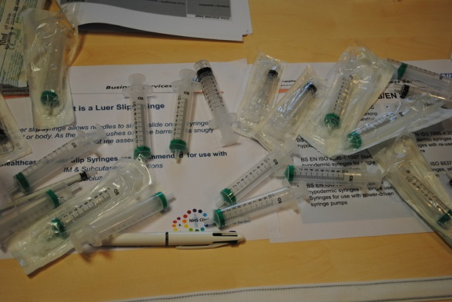
Product Evaluation Modes
Clinical Simulation
Clinical In Use
Independent Laboratory Testing

Slide 20
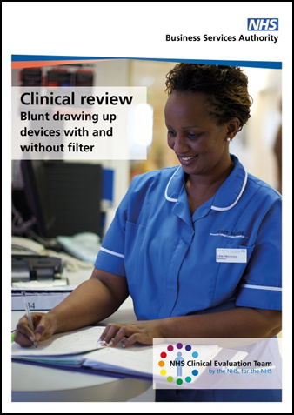
Clinical Review Reports
Clinical Review
Pathway methods
Product assessment results
Recommendations for the future

Slide 21
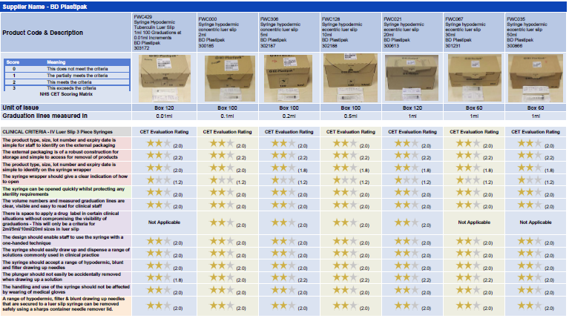
Product assessment results – Supplier review

Slide 22




Star rating system
Exceeds criteria
Meets criteria
Partially meets criteria
Did not meet criteria

Slide 23




First four clinical review reports now available
www.nhsbsa.nhs.uk/CET

Slide 24
Finding out more
Clinical Reference Board website
http://www.nhsbsa.nhs.uk/CommercialServices/5495.aspx
Clinical Evaluation Team dedicated email
clinical.evaluationteam@nhs.net
Clinical Evaluation Team website
http://www.nhsbsa.nhs.uk/CET

Slide 25
‘Quality, safety and value are at the heart of our work and it’s important that we use our clinical experience to deliver high standards of care while reducing cost and waste in the NHS.’
Mandie Sunderland
Chair, Clinical Reference Board
(Governing body of the NHS Clinical Evaluation Team)

