Slide 1
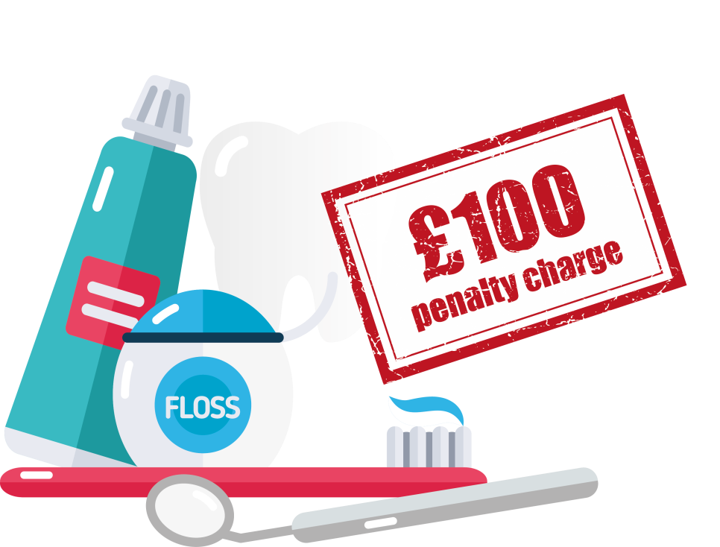
^{Over 428,000}
people received a penalty charge notice after claiming free dental care last year.
Don’t assume you’re entitled.
Check at www.nhsbsa.nhs.uk/freedental

