Slide 1

Electronic Prescription Service
EPS support provided by NHSBSA

Slide 2
Agenda
Welcome and introductions
The Electronic Prescription Service
NHSBSA offering
Data
Benefits
NHSBSA Support (including eRD)
Challenges
Contact us
Questions

Slide 3
The Electronic Prescription Service
The Electronic Prescription Service (EPS) creates savings by making prescribing and dispensing processes more efficient while improving patient care.
EPS currently accounts for 63% of all primary care prescribing*, which has already created significant benefits across the NHS. If the level of EPS use reached its full potential (currently 91%), the associated benefits would be huge.
*as of August 2018

Slide 4
NHSBSA Offering
We are working in collaboration with NHS Digital and are committed to supporting CCGs, practices, pharmacies and other NHS organisations in maximising their EPS use, delivering the best possible service to patients.
To help us understand the support required, we work on an individual basis with practices, maintaining a close working relationship throughout the EPS process. We can offer a range of reports and other resources to help your organisation at each stage of the journey towards making the most of EPS.
We have developed an EPS Prescribing Dashboard which offers key metrics on EPS use, electronic repeat dispensing volumes and EPS opportunity items.

Slide 5
Data
Our dashboards and comparators help CCGs and practices to identify opportunities for increasing EPS which can be found at www.nhsbsa.nhs.uk/EPSDashboard
We can also discuss potential admin time savings based on these opportunities

Slide 6
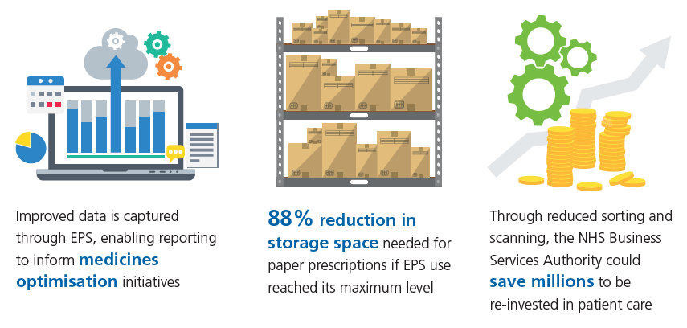
Benefits for prescribers, patients and the wider NHS

Slide 7
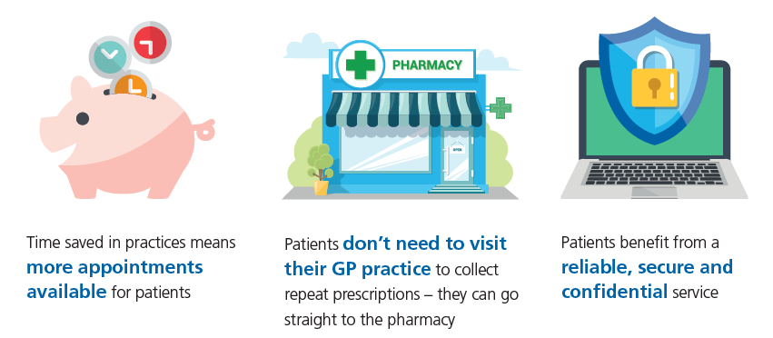
Benefits for prescribers, patients and the wider NHS

Slide 8
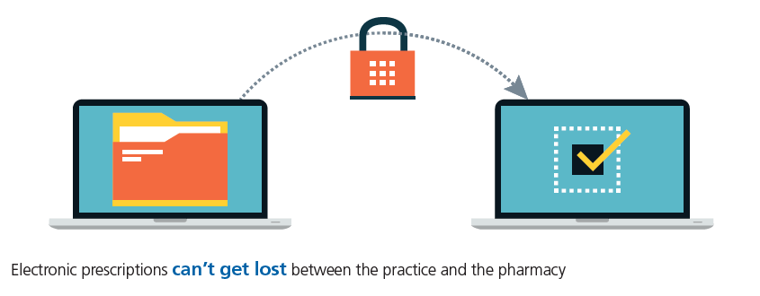
Benefits for prescribers, patients and the wider NHS

Slide 9
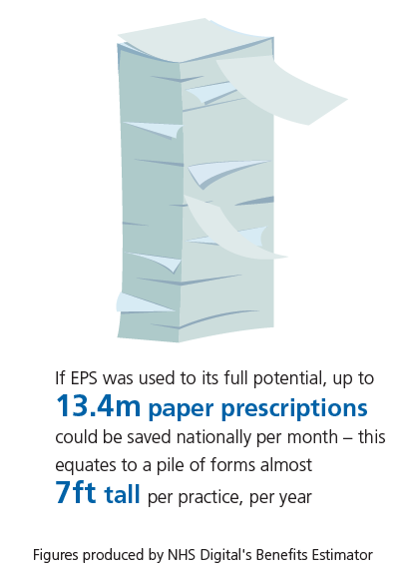
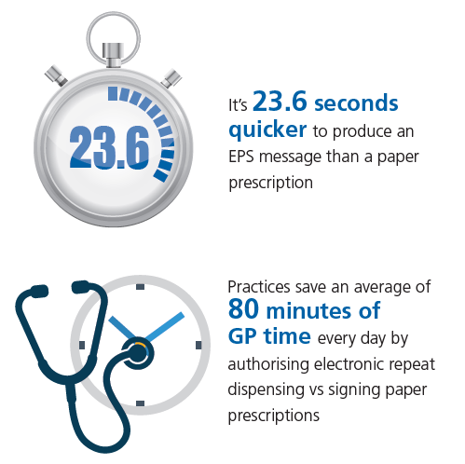
Benefits for prescribers, patients and the wider NHS

Slide 10
NHSBSA Support
We can provide detail on resources currently available to practices to help engage with patients, including:
Text Messaging Content – A collection of messages that can be sent out to patients via text to inform them about EPS and the benefits of using it. The messages can be sent out at the same time as other messages, such as, appointment reminders.
https://www.nhsbsa.nhs.uk/sites/default/files/2017-10/EPS%20Text%20Messages.pdf

Slide 11
NHSBSA Support
Pharmacy Letter – A letter that can be given to local pharmacies practices work with that explains the promotion of EPS and eRD. This can be placed alongside the sorted piles of paper prescriptions which are collected by surrounding pharmacies. Do this a number of times to keep promoting the message. Good communication is paramount between the GP and pharmacy to ensure EPS runs smoothly with fewer errors.
https://www.nhsbsa.nhs.uk/sites/default/files/2017-10/EPS%20letter%20template.pdf

Slide 12
NHSBSA Support
Waiting Room Messaging Content – A collection of messages that can be displayed on waiting room screens than can be viewed by the patients. These messages will come across the screen and give help and advice about the benefits of EPS. This messaging will benefit repeat patients and is mainly focused on those patients using paper repeat prescribing.
https://www.nhsbsa.nhs.uk/sites/default/files/2017-10/EPS%20Waiting%20Room%20Messages.pdf

Slide 13
NHSBSA Support – System specific materials
Non-nominated Patient Searches (SystmOne) – We encourage all practices using SystmOne to run a search to identify patients currently on repeat medicines who do not have an EPS nomination as this group of patients are most likely to see the benefit of EPS. We can provide a system specific step by step guide to help set up the searches.
https://www.nhsbsa.nhs.uk/sites/default/files/2017-10/SystmOne%20non-nominated%20repeat%20patient%20search.pdf

Slide 14
NHSBSA Support – System specific materials
Non-nominated Patient Alerts (SystmOne) – A guide to set up a pop up system so messages can pop up on patient files to remind the prescriber to promote EPS to the patient.
https://www.nhsbsa.nhs.uk/sites/default/files/2017-10/EPS%20SystmOne%20pop-up%20protocol.pdf

Slide 15
NHSBSA Support
All of the support materials previously listed can also be found on our website at www.nhsbsa.nhs.net/EPS

Slide 16
NHSBSA Support – eRD
Up to 410 million repeat prescriptions are generated every year, which is equivalent to an average of more than 375 per GP, per week.
Two thirds of prescriptions issued in primary care are repeat prescriptions
This accounts for 80% of NHS medicine costs for primary care.

Slide 17
NHSBSA Support – eRD
eRD Patient Flyer – This is designed to be handed out to patients who are potentially suitable for eRD.
https://www.nhsbsa.nhs.uk/sites/default/files/2018-05/eRD%20leaflet%20A5%20%28V2%29%20%28Local%29%2005.2018.pdf
GP practices, Dentists, Opticians and Pharmacies can order through the following link www.pcse.england.nhs.uk
Trusts, CCGs, Local Authorities etc. can order here www.nhsforms.co.uk

Slide 18
NHSBSA Support – eRD
NHS Numbers for patients potentially suitable for Electronic Repeat Dispensing (eRD)
To support GP Practices in maximising the benefits of the Electronic Prescription Service (EPS) and eRD, we can provide NHS numbers of patients who are potentially suitable for eRD to practices who request this information and meet the requirements outlined on this form.
The purpose of the data we may provide in response to this request is to assist healthcare professionals with direct clinical care of patients to assess their suitability for eRD. If a patient is deemed suitable for eRD a conversation must be held with them and they should only be transferred to eRD with their consent.
To request this information, please visit www.nhsbsa.nhs.uk/eRD under the heading ‘Identifying suitable patients for eRD’

Slide 19

Challenges
We would like to know about additional challenges you face when looking to increase EPS use. We will take these away and discuss with CCGs and NHS Digital to understand how best to support you and provide solutions.

Slide 20
Contact Us
Visit www.nhsbsa.nhs.uk/EPS or email us at NHSBSA.EPSsupport@nhs.net
We’ll contact you to discuss the support you need. We may already have resources that can help you, or we can work with you to develop a bespoke support package to help you achieve your targets.
We’d also like to gather some examples of best practice to further develop the support we can offer.

