Slide 1
EPS
“Developing the best way forward for practices and pharmacy to maximise EPS”

Slide 2
The Benefits of EPS and eRD

Slide 3
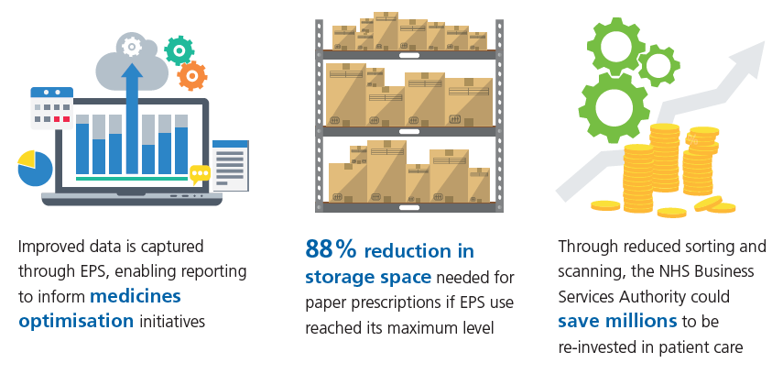
Benefits for prescribers, patients and the wider NHS

Slide 4
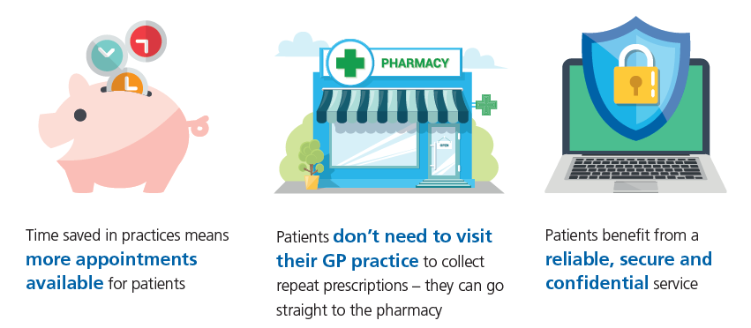
Benefits for prescribers, patients and the wider NHS

Slide 5
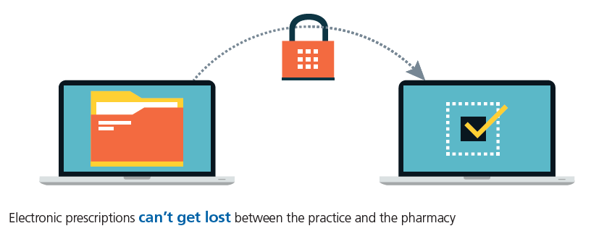
Benefits for prescribers, patients and the wider NHS

Slide 6
Benefits for Dispensers
Automated downloads, making prescription processing more efficient
Less time spent on administration and collecting prescriptions, which means more time for helping customers
Improved stock control and greater accuracy
A prescription collection service no longer required
between pharmacy and practices

Slide 7
Benefits for Dispensers
Improved patient satisfaction through reduced waiting times
Increased accuracy, meaning fewer prescription queries
Less sorting and less paper to send to NHS Prescription Services

Slide 8
NHSBSA Prescriber Support Model

Slide 9
Increase EPS use
Many patients not using EPS may not be convinced by the benefits to themselves
The NHSBSA has developed content specifically to engage these patients looking more at the impact to the wider NHS
Promote to patients
waiting room slides
waiting room message content
pharmacy letter template

Slide 10
Introduce eRD
To support GP Practices in getting started with eRD we can help identify potentially suitable patients.
To request this information the following form should be completed and returned to nhsbsa.epssupport@nhs.net
Identifying suitable patients for eRD
eRD data requests overview
eRD data request form
To help in promoting eRD to these and other suitable patients we have the following:
eRD patient flyer
eRD waiting room slides
Practices receiving our data in 2017/18 increased their eRD over 3% more than similar practices who did not get our data
That equates to a minimum of 5 hours GP time saved each month!

Slide 11
Maximise EPS and eRD
Checking your EPS and eRD usage on a regular basis will help ensure you maximise your potential
Share best practice with other sites in your area
Use available handbooks, guides and support
Inform and educate patients
Differentiate between other digital services (Online access) and EPS and eRD
Make sure patients don’t continue to order medication once on eRD
Make sure all patients using online access are aware of EPS

Slide 12
NHSBSA Dispenser Support Model

Slide 13
EPS and eRD utilisation
TOP TIPS
Communication is key between practice and pharmacy which is why we are arranging workshops to facilitate communication
Use the prescription tracker when you need to locate EPS scripts
Promote to patients using alternative messages based around savings EPS generates to the NHS (research recently conducted by the NHSBSA with over 800 patients suggest this is good way to increase nominations)
Identify patients potentially suitable for eRD

Slide 14
What we do to support pharmacies
Arrange events to support pharmacists through their EPS journey
Provide materials to engage with patients, if we do not hold materials suitable for your needs we may be able to build specific packages
Work with system suppliers to find training materials
Report on dispensing data through our dashboards

Slide 15
Staying Connected
Twitter: @NHSBSA
Website: www.nhsbsa.nhs.uk
Email : nhsbsa.epssupport@nhs.net

