Slide 1
Let’s talk EPS
“Developing the best way forward for practices and pharmacy to maximise EPS”

Slide 2
An Introduction to NHSBSA Primary Care Services

Slide 3
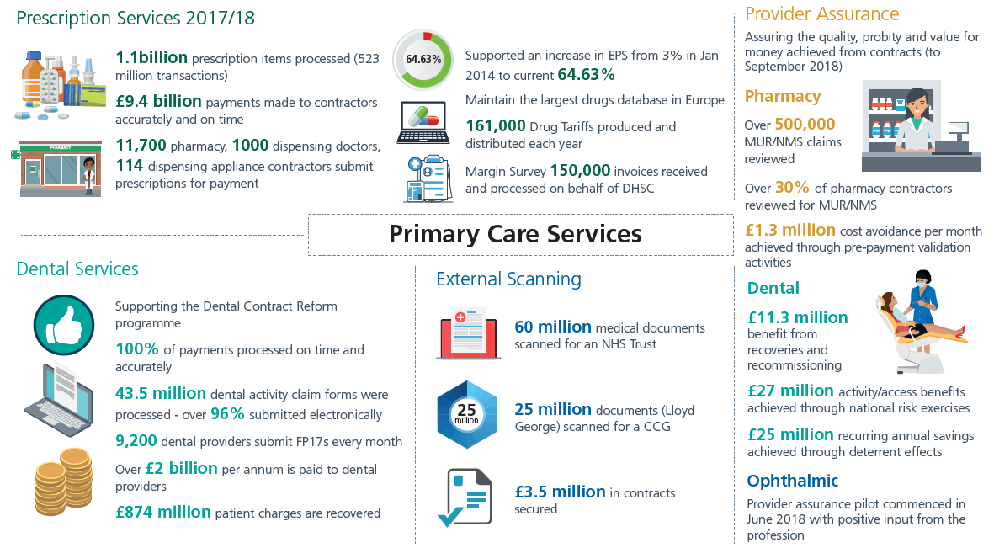
Notes:
The NHSBSA’s services include:
helping patients pay for their health costs
providing EHIC cards
calculating reimbursement and remuneration to dispensing contractors and NHS dentists
providing prescribing and dispensing information to the NHS
assessing bursary claims from healthcare and social care students
preventing and investigating fraud, and protecting NHS staff
administering pensions for NHS staff

Slide 4
The Benefits of EPS and eRD

Slide 5
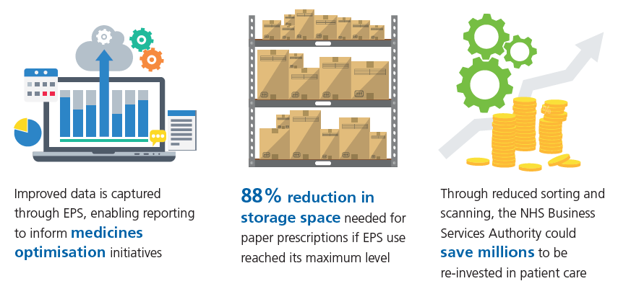
Benefits for prescribers, patients and the wider NHS

Slide 6
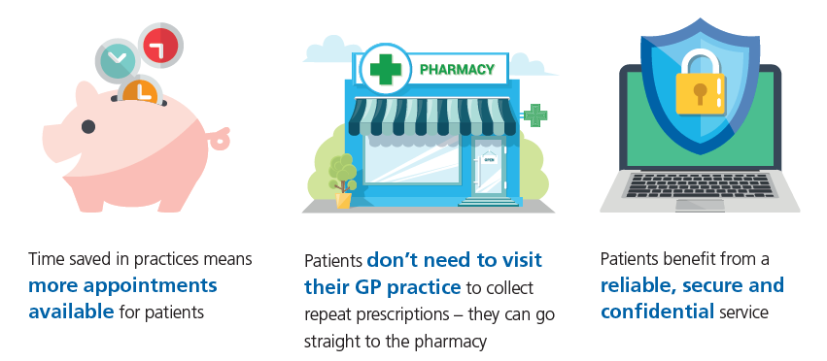
Benefits for prescribers, patients and the wider NHS

Slide 7
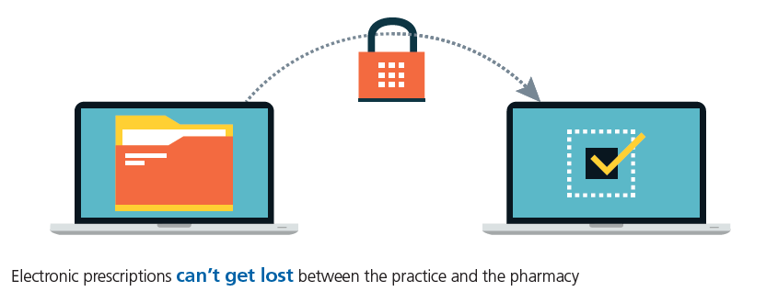
Benefits for prescribers, patients and the wider NHS

Slide 8
Benefits for Dispensers
Automated downloads, making prescription processing more efficient
Less time spent on administration and collecting prescriptions, which means more time for helping customers
Improved stock control and greater accuracy
A prescription collection service no longer required
between pharmacy and practices

Slide 9
Benefits for Dispensers
Improved patient satisfaction through reduced waiting times
Increased accuracy, meaning fewer prescription queries
Less sorting and less paper to send to NHS Prescription Services

Slide 10
NHSBSA Prescriber Support Model

Slide 11
Your EPS and eRD journey
Promote to patients
Identify suitable patients
Continuous support and improvement
Efficient use
Identify and address challenges
Understand the process
Promote to patients
Getting started
Informing and educating patients
Collaborate with NHS Digital, CCGs and LPCs.
We work on an individual basis with practices and pharmacies, maintaining a close working relationship throughout.
We offer a range of resources to help your organisation at each stage of the journey towards getting the most out of EPS.
We have developed both an EPS Prescribing Dashboard and Dispensing Dashboard.
Increase
EPS use
Introduce eRD
Maximise EPS and eRD

Slide 12
Increasing EPS use – Patient engagement
Many patients not using EPS may not be convinced by the benefits to themselves
The NHSBSA has developed content specifically to engage these patients looking more at the impact to the wider NHS
This content is available for use:
As a slide show
Waiting room messaging content (can also be used as text messaging content)
We also have other resources to help engage pharmacy and identify suitable patients for EPS
TOP TIP: Search for patients on repeats and send them this content via SMS (iPLATO /MJog ) to inform them of the EPS service

Slide 13
Increasing EPS use – Nominations
EPS still relies on patient choice through nomination.
Patients must be fully informed about EPS before the nomination can be set on the system.
Nomination consent doesn't have to be in writing, but you do need to have an auditable process.
TOP TIPS:
Set monthly nomination targets
Incorporate a section on recording patient consent for EPS nominations in New Patient Registration Processes.
Set up alerts to remind GPs to speak to non-nominated patients during consultations
Encourage local pharmacy to nominate prescription collection service patients
Promote EPS and acquire nomination information on recall letters
Promote EPS to all patients using online access
Notes:
(e.g. protocol alongside a data entry template that captures the way with which the patient was asked the nomination question)

Slide 14
Increasing EPS use – Other useful tips
Correct and consistent smartcard use
Ensure no PDS mismatches
Staff training – both existing and new staff
Regularly monitoring stats
Use searches regularly to identify suitable patients
Use the EPS Tracker
Use EPS for Appliances with patient consent
Notes:
Locums – Some ideas but will depend on if can be applied by practices:
Add roles to smartcards (as per practice policy) – regular locums
Re-allocation of Locum and regular GPs workload - regular GPs to do on EPS / All Scripts
: https://portal2.national.ncrs.nhs.uk/prescriptionsadmin

Slide 15
Increasing EPS use – Identifying challenges & addressing these
Communication is key
Arrange workshops with local pharmacies
Educate and inform patients
Work with PPGs

Slide 16
Introduce eRD – How it works
https://www.youtube.com/watch?v=zzaNeAaelAo&feature=youtu.be

Slide 17
Introduce eRD – Getting started
Ensure everybody in the practice is aware of eRD and how it works
Run an eRD workshop
Create/update your surgery's eRD strategy (include admin team and clinical team)
Review current eRD performance and set a target
Invite local pharmacy and encourage collaboration
Nominate champions for the practice and pharmacy
Start slowly, identifying and engaging with patients:
At medication reviews
Opportunistically
By advertising throughout the surgery
Target specific conditions/regimes (hypertension/diabetes)

Slide 18
Introduce eRD – NHSBSA data
To support GP practices we can provide NHS numbers for patients who are potentially suitable for eRD.
This data shows “stable” patients who have had no change in their medication in at least 10 of the last 12 months
Information governance protocols need to be observed to receive the data
To request this information, please visit www.nhsbsa.nhs.uk/eRD
Practices receiving our data in 2017/18 increased their eRD over 3% more than similar practices who did not get our data
That equates to a minimum of 5 hours GP time saved each month!

Slide 19
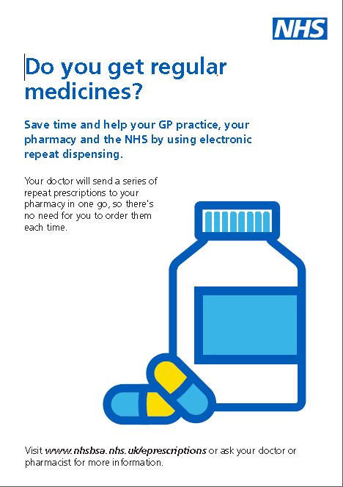
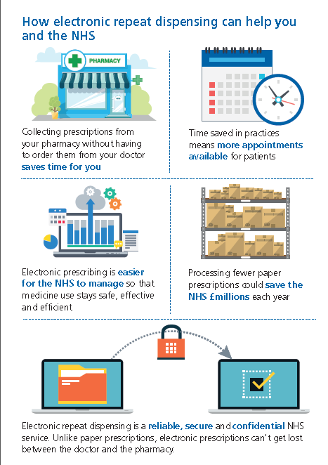
Introduce eRD – Patient engagement
NHSBSA patient flyer
GP practices, Dentists, Opticians and Pharmacies can order through the following link www.pcse.england.nhs.uk
Trusts, CCGs, Local Authorities etc. can order here www.nhsforms.co.uk
Work with PPGs
Patient presentations

Slide 20
Maximise EPS and eRD
Checking your EPS and eRD usage on a regular basis will help ensure you maximise the potential to increase your usage
Share best practice
Use available handbooks, guides and support
Inform and educate patients
Differentiate between other digital services and EPS
Make sure patients don’t continue to order medication once on eRD

Slide 21
Challenges
We would like to know about additional challenges you face when looking to increase EPS use.
We will take these away and discuss with CCGs, LPCs and NHS Digital to understand how best to support you and provide solutions.

Slide 22
Staying Connected
Twitter: @NHSBSA
Website: www.nhsbsa.nhs.uk
Email : nhsbsa.epssupport@nhs.net

