Slide 1
Let’s talk EPS
“Developing the best way forward for practices and pharmacy to maximise EPS”

Slide 2
An Introduction to NHSBSA Primary Care Services

Slide 3
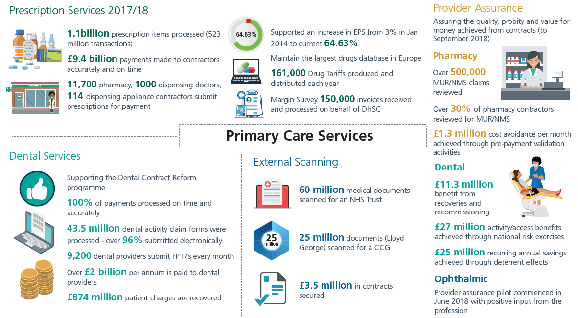
Notes:
The NHSBSA’s services include:
helping patients pay for their health costs
providing EHIC cards
calculating reimbursement and remuneration to dispensing contractors and NHS dentists
providing prescribing and dispensing information to the NHS
assessing bursary claims from healthcare and social care students
preventing and investigating fraud, and protecting NHS staff
administering pensions for NHS staff

Slide 4
The Benefits of EPS and eRD

Slide 5
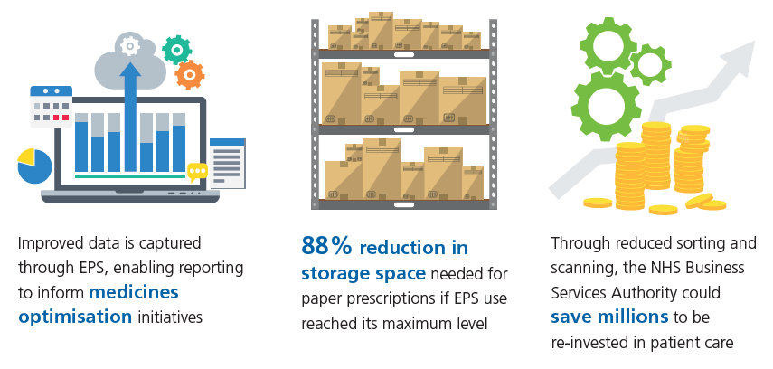
Benefits for prescribers, patients and the wider NHS

Slide 6
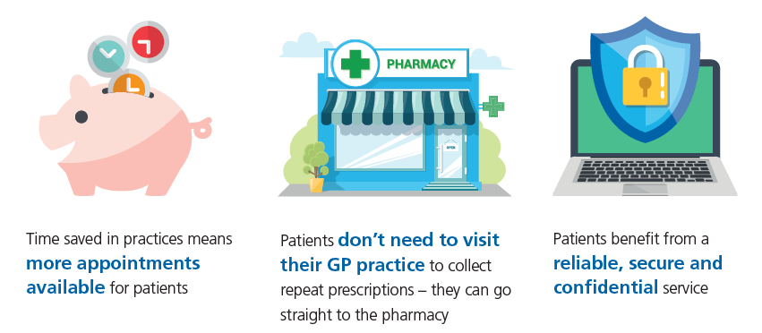
Benefits for prescribers, patients and the wider NHS

Slide 7
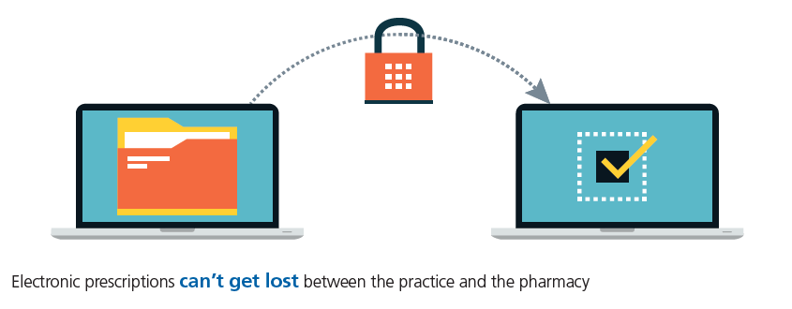
Benefits for prescribers, patients and the wider NHS

Slide 8

Benefits for Dispensers
Automated downloads, making prescription processing more efficient
Less time spent on administration and collecting prescriptions, which means more time for helping customers
Improved stock control and greater accuracy
A prescription collection service no longer required
between pharmacy and practices

Slide 9

Benefits for Dispensers
Improved patient satisfaction through reduced waiting times
Increased accuracy, meaning fewer prescription queries
Less sorting and less paper to send to NHS Prescription Services

Slide 10
NHSBSA Dispenser Support Model

Slide 11
EPS and eRD utilisation
Communication is key between practice and pharmacy which is why we are arranging workshops such as this to facilitate communication
The prescription tracker is a key component of EPS as electronic prescriptions can’t get lost
Promote to patients using NHSBSA messaging, if we do not hold materials suitable for your needs we may be able to build specific packages
Identify patients potentially suitable for eRD
We are also working closely with system suppliers for Pharmacy software

Slide 12
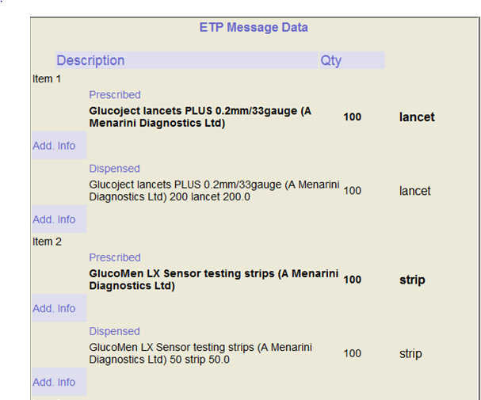
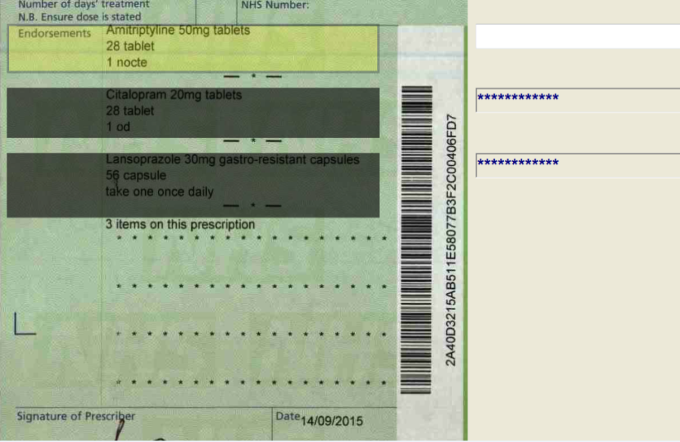
How we process prescriptions
In 2007 we redesigned our systems to ensure that we would be able to accept electronic prescriptions
We use scanners and intelligent character recognition software (ICR) to read a lot of the information on paper prescriptions we need to calculate payments.
We follow the rules set out in the NHS England and Wales Drug Tariff for both paper and EPS forms

Slide 13
Electronic prescriptions and tokens
  Tokens are scanned for exemption purposes, there is no need to submit tokens that are automatically age exempt. We use the exemption / charge paid status that you have submitted in your Electronic Reimbursement Endorsement Message (EREM)
  Ensure all patient information regarding exemption or charge paid is set up in your system before you send the Dispense Notification when the patient collects their medication - some systems default to ‘chargeable’ status
Notes:
You don’t need to send tokens that are automatically age exempt (i.e. for patients below the age of 16 or over 60) to NHS Prescription Services.
Tick both boxes on the submission document if you’re submitting ETP tokens and EPS release 2 claim messages.

Slide 14
Electronic claiming
Notes:
Electronic Reimbursement Endorsement Messages (EREM) don’t need to be sent all together at the end of the month
you can send them in real time, at the end of the day, in batches or weekly.
We must receive by the 5th of the month following the DN being sent to be paid in the correct month.
If a DN is sent in August and the EREM is received by 5th September, payment will be made in August. However if the item is dispensed in August but the EREM is not received until 6th September, payment will be made in September.
However .. if an item is dispensed on 1st September the dispense notification must also be sent on 1st September. However, even if the corresponding EREM is sent to NHS Prescription Services on or before 5 September, payment will be made for September and not for August.

Slide 15
EPS v Paper returns
Only around 0.05% of all EPS items are referred back to contractors compared to around 0.17% of paper items
The majority of returns are due to missing packs, prices and suppliers
As items prescribed via EPS must match the DM+D listing, this also avoids the return of a lot of appliances and handwritten items
Notes:
The prescription details are returned if it isn’t clear what has been dispensed or if a price is endorsed, it isn’t clear what this relates to.
Prescriptions may referred back for a product is any part of the Tariff, so will also cover Appliances, Specials, ACBS list etc
See hand out with ‘referred reasons’
The majority of our returns are missing packs, price and suppliers. We also return a lot of appliances which are not listed in dm+d, and we require a brand. For example, pen needles and eye drops.

Slide 16
What we do to support pharmacies
Arrange events such as this to engage with practices
Provide materials to engage with patients
Work with system suppliers to find training materials
Report on dispensing data through our dashboards

Slide 17
Pharmacies & eRD
Contractual obligation to ask 4 questions on eRD:
  Have you seen any Health Professional since your last repeat was supplied?
  Have you recently started taking any new medicines either on prescription or that you have bought over the counter?
  Have you been having any problems with your medication or experiencing any side effects?
  Are there any items on your repeat prescription that you don’t need this month?

Slide 18

Challenges
We would like to know about additional challenges you face when looking to increase EPS use.
We will take these away and discuss with CCGs, LPCs and NHS Digital to understand how best to support you and provide solutions.

Slide 19
Staying Connected
Twitter: @NHSBSA
Website: www.nhsbsa.nhs.uk
Email : nhsbsa.epssupport@nhs.net

