Slide 1
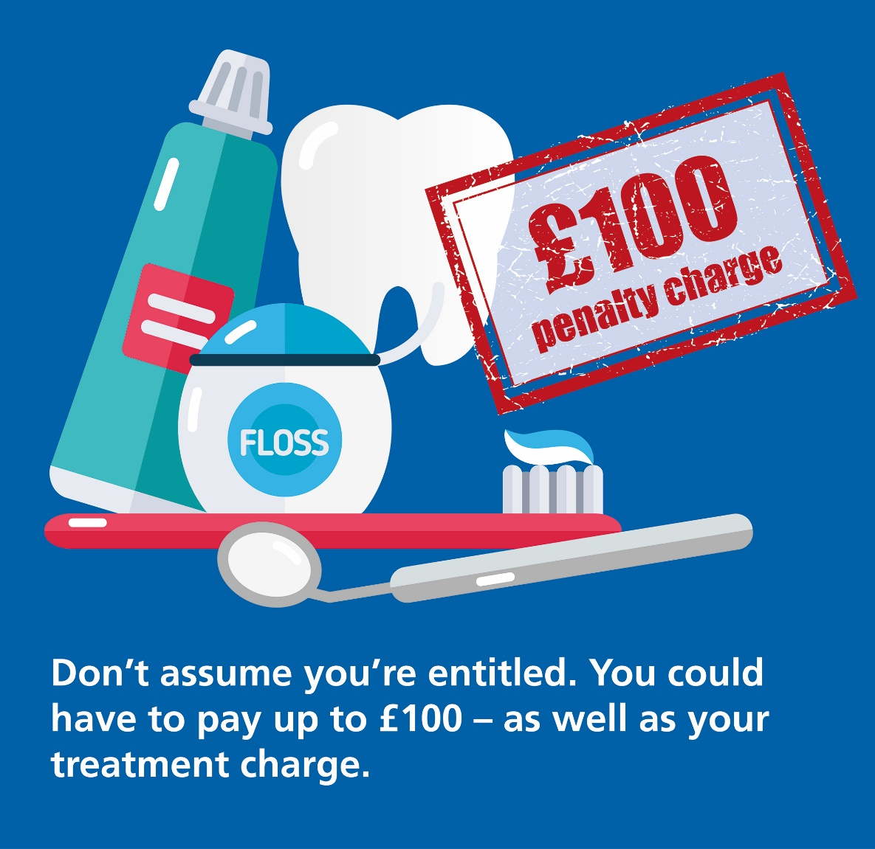
Universal Credit and free treatment

Slide 2
Are you getting Universal Credit?
Not everyone who gets Universal Credit is entitled to free dental care.
‘Last assessment period’ means the assessment period that ended immediately before the date you claim free treatment. It runs for a calendar month.
You’re only entitled if your earnings during your last assessment period were:
£435 or less
£935 or less if your Universal Credit includes a payment for a child or you have limited capability for work or work-related activity

Slide 3
Are you getting Universal Credit?
Not everyone who gets Universal Credit is entitled to free dental care.
You can check your earnings for your last assessment period by signing in to your online Universal Credit account to see your statement.

Slide 4
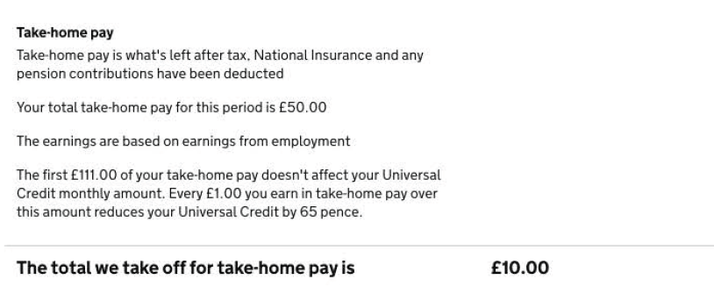
Are you getting Universal Credit?
Not everyone who gets Universal Credit is entitled to free dental care.
Your earnings will be shown on your statement as ‘Your total take-home pay for this period’.

Slide 5
Are you getting Universal Credit?
Not everyone who gets Universal Credit is entitled to free dental care.
If you claim Universal Credit as a couple, the earnings limit applies to the joint income of you and your partner.
You’re only entitled if your earnings during your last assessment period were:
£435 or less
£935 or less if your Universal Credit includes a payment for a child or you have limited capability for work or work-related activity

Slide 6
Are you getting Universal Credit?
Not everyone who gets Universal Credit is entitled to free dental care.
If you meet these conditions, you’re also entitled to free NHS prescriptions, sight tests, wigs and fabric supports. You can also get help with the cost of glasses or contact lenses and travel to receive NHS treatment.
You’re only entitled if your earnings during your last assessment period were:
£435 or less
£935 or less if your Universal Credit includes a payment for a child or you have limited capability for work or work-related activity

Slide 7
Are you getting Universal Credit?
Not everyone who gets Universal Credit is entitled to free dental care.
If your earnings are too high, you can apply for help with the cost of dental treatment and other health costs through the NHS Low Income Scheme: www.nhsbsa.nhs.uk/lowincomescheme
You’re only entitled if your earnings during your last assessment period were:
£435 or less
£935 or less if your Universal Credit includes a payment for a child or you have limited capability for work or work-related activity

Slide 8
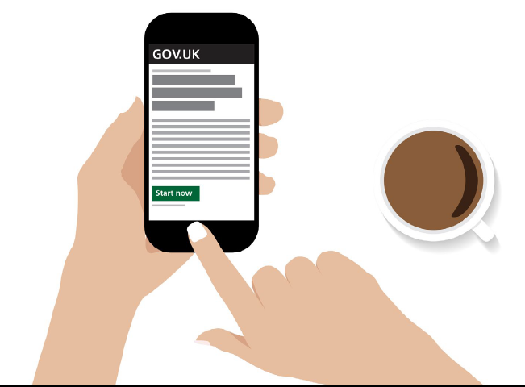
Don’t assume you’re entitled to free dental treatment.
Check that you’re entitled at:
www.nhs.uk/checkbeforeyoutick

