Slide 1
Orthodontic Clinical Monitoring and Reporting - Outcomes

Slide 2
Key
Category | Description | Expected interval (months)
Red risk | Unsatisfactory, requiring further investigation. Commissioners will arrange an urgent discussion with the provider. | 12
Amber risk | Satisfactory, but where reservations were expressed for the provider to mitigate with appropriate action. | 24
Green risk | Good, satisfying all relevant criteria. | 36

Slide 3
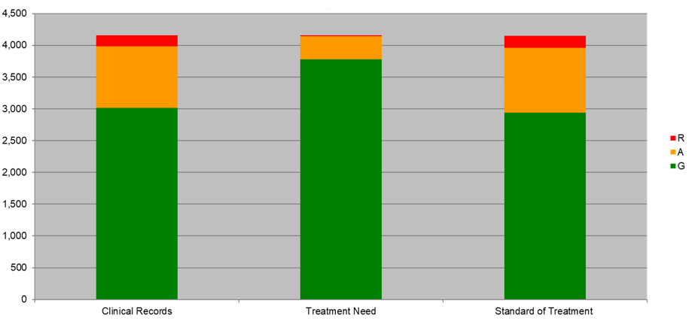
OCA Reporting Outcomes by number of cases – January 10 to April 2022

Slide 4
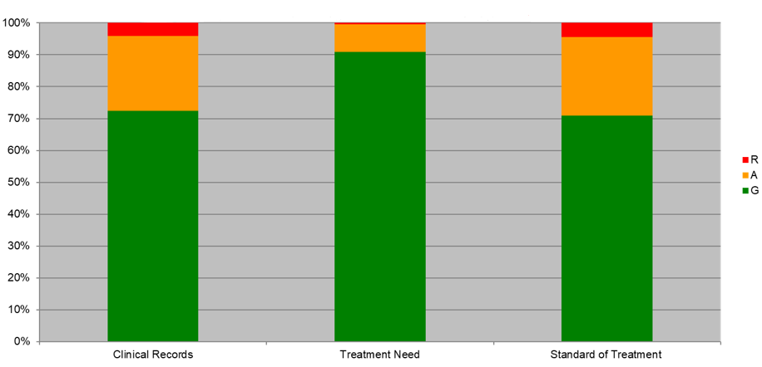
OCA Reporting Outcomes by percentage of cases – January 10 to April 2022

Slide 5
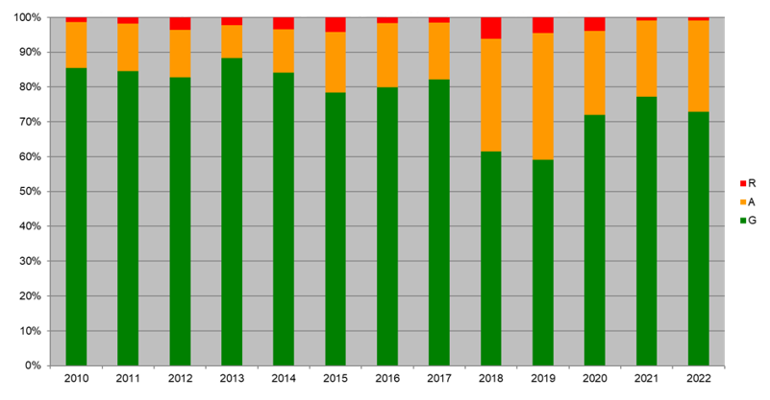
Overall OCA Reporting Outcomes by percentage of cases – 2010 to 2022

