Slide 1
NHS Dental Services - Privacy notice
How we
handle
your data

Slide 2
Who we are
We make sure that your dentist gets paid for providing NHS services and looking after you.
We are the NHS Business Services Authority and we support the rest of the NHS to provide care.

Slide 3
Why do we collect this information?
To help us make sure that NHS services are being provided in the best possible way for everyone, the law requires us to hold some information about you.
This is known as collecting information under our public task.

Slide 4
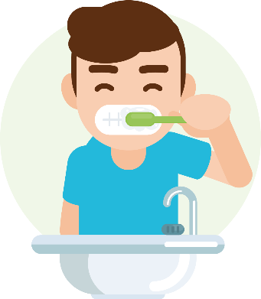
The information held about you
We hold information about:
your name, address and date of birth
the dental practice that looks after you
when you visited the dentist
the care you received (this could include a brace you might have had fitted or any fillings you have)

Slide 5
We use your information to:
pay your dentist according to the treatment you’ve had
make sure that NHS services are giving everyone the best care
We could also use your information to check for errors and to write to you with questions about your visit to the dentist.
We keep your information safe on computer systems that meet security and industry standards.
How we use your information

Slide 6
Who we share your data with
Sometimes we have to share your personal data to do our work. We’re very careful about how we do this.
There is a list of who we could share your information with on our Privacy Notice. If you need to, ask someone to help you access this list.

Slide 7
How long do we keep your information for?
We usually keep your information for eight years from the date of your visit to the dentist.
We may keep your information longer if you have visited a dental practice that is under a different set of rules, known as Dental Contract Reform.
If you, your parent or carer want to know more about how long we keep your information for, please email our data protection officer at dataprotection@nhsbsa.nhs.uk

Slide 8
Know your rights
You have rights over your personal information. These rights include:
knowing what information we have about you
asking to see or have a copy of your information
correcting any information that is wrong, and more
There is a full list of your rights on our privacy page, but please, if you need to, ask someone to help you with this.

Slide 9
Get in touch
If you want to know more about the personal information we have of yours, or if you want to raise a question with us then please just ask.
If you are under 13 your parent or carer would need to do this for you, however, if you are over 13, then you can write to our data protection officer at:
dataprotection@nhsbsa.nhs.uk

