Slide 1
NHSBSA Dental Services
Wales Patient Survey: General Dental Contracts
April 2023 – March 2024

Slide 2
Introduction
The Welsh General Dental Patient Survey contains questions designed to measure a patient's experience at their dental practice, as well as demographic questions about a patients' personal characteristics. The same questions were asked in 2023/2024 as in 2022/2023 so direct comparisons can be made. Questions are available at the end of the report.
The survey is distributed on a weekly basis via email and SMS text message to patients who have received dental treatment at a point in the previous six weeks in Wales. On average, it was sent to 2,130 patients a week with an average response rate of 28% (600 responses a week).
This report compares patient experiences between those who attended a dental practice under Contract Reform or Units of Dental Activity (UDA) Contract as well as comparing 2023/2024 with 2022/2023 where it provided useful insight.
Between 1 April 2023 and 31 March 2024 a total of 31,696 patients started the survey. Responses from contracts that could not be determined as either being Reform or UDA were excluded from this report, leaving 31,275 responses. Responses from patients who indicated on the first question that the information regarding the dental practice they visited was incorrect are also excluded from this report as they were automatically routed to the end of the survey and completed no further questions. This leaves a final base size of 30,243 valid patient responses.
Base sizes may differ from this number throughout the report as questions are optional.
Percentages in this report have been rounded, in some cases the percentage will not add up to exactly 100%.
Where reference is made to statistical significance, this indicates that we are confident at a 95% level that the differences between the two contracts and/or years are actual and not due to chance.
On the charts the 2023/24 year is referred to as 2024 and 2022/23 year is referred to as 2023.

Slide 3
Patient Experiences – Involvement
Consistent with 2023, 91% of patients agree/strongly agree they were involved in decisions made about their dental care as much as they wanted to be in 2024.
Consistent with 2023, a statistically significant difference was observed in 2024, with a higher percentage of patients at UDA practices (93%) reporting being involved in these decisions compared to those in Contract Reform practices (90%).
There was a statistically significant decrease of one percentage point in agreement for involvement in decisions for Contract Reform for 2024 (90%) compared to 2023 (91%). There was no significant difference for UDA Contract from 2023 to 2024.
From dark to light blue: Agree or Strongly Agree → Neither Agree nor Disagree → Disagree or Strongly Disagree

Slide 4
Patient Experiences - Travel
Agreement levels remain consistent year on year and across both Contract Reform and UDA contracts, with no statistically significant differences found.
Between 91% and 92% of respondents agree or strongly agree that they are satisfied with the distance they have to travel to their dental practice.

Slide 5
Patient Experience – Booking
Overall, there has been a statistically significant increase of three percentage points in the number of patients who agree/strongly agree that they were able to book an appointment at a convenient time to them in 2024 (89%), compared to 2023 (86%).
Patients treated by a UDA practice were statistically significantly more likely to agree/strongly agree that they were able to book an appointment at a convenient time that suited them (93%) compared to those at Contract Reform practices (88%). This is consistent with last year's findings.
There has been a statistically significant increase of two percentage points in patients who received treatment from a Contract Reform practice, rising from 86% last year to 88% this year. No statistical significant differences were found for UDA Contracts from 2023 to 2024.
From dark to light blue: Agree or Strongly Agree → Neither Agree nor Disagree → Disagree or Strongly Disagree

Slide 6
Patient Experience: Helpful
Consistent with 2023, 96% to 98% of patients agree/strongly agree that staff members are helpful.
Patients seen under the UDA Contract report have a higher ‘agree/strongly agree’ rating (98%) compared to those seen under Contract Reform (96%). This difference is statistically significant and consistent with last year's findings.
No other statistically significant differences were found from 2023 to 2024 for Combined, UDA Contract or Contract Reform.

Slide 7
Patient Experience: Respectful
Consistent with 2023, 97% to 98% of patients agree or strongly agree that staff members are respectful.
Patients seen under the UDA Contract give higher ‘agree/strongly agree’ ratings (98%) compared to those seen under Contract Reform (97%). This is a statistically significant difference and consistent with last year's findings.
No other statistically significant differences were found from 2023 to 2024 for Combined, UDA Contract or Contract Reform.

Slide 8
Your Dental Health: risk(s) or area(s) for improvement
Overall, 78% of patients reported discussing risks and areas for improvement with their dental health, this is a statistically significant decrease by one percentage point when compared to 79% of patients in 2023.
More patients on Contract Reform report that the dentist discussed risks/improvements (78%) than those on the UDA Contract (74%) in 2024. This is a statistically significant difference and consistent with last year’s findings.
There was a statistically significant decrease by two percentage points from 80% to 78% in 2024 for Contract Reform in the number of patients reporting that the dentist discussed risks or areas for improvement.

Slide 9
Your Dental Health: possible consequences
Overall, in 2024, 92% of patients reported that the consequences of action not being taken was discussed with them, consistent with 91% in 2023.
No statistically significant differences were found from 2023 to 2024 or between the contract types.
Between 91% and 93% of patients reported that the dentist explained possible consequences if action was not taken.

Slide 10
Your Dental Health: advice
Overall, in 2024, 97% of patients reported that they were given advice on how to improve their oral health, consistent with 96% in 2023.
No statistically significant differences were found from 2023 to 2024 or between the contract types.
Between 96% and 97% of patients were given advice on how to improve their oral health.
Consistent with 2023, 99% of patients understand the information provided by their clinician. Both types of contracts are also consistent year on year at 99%.
From dark to light blue: Yes → No

Slide 11
Satisfaction with Quality of Dentistry
Satisfaction is calculated in line with the NHSBSA reporting practices, a scale of 1-10 is used and scores of 7 or above are classed as being 'satisfied’. A percentage is calculated of those scoring 7 or above, out of all responses to the question, to give a satisfied percent.
Overall, for 2024 patient satisfaction relating to the quality of NHS dentistry is 92% which is consistent with 93% in 2023. The ratings for both types of contract are also consistent between 2023 and 2024.
For 2024 UDA Contract practices (95%) continue to be rated higher for the quality of NHS dentistry than Contract Reform practices (92%). This difference is statistically significant and consistent with last year's findings.

Slide 12
Overall Satisfaction with Patient Experience
Overall satisfaction for patient experience for 2024 is consistent with last year at 94%.
There has been a statistically significant increase by one percentage point in satisfaction with patient experience for UDA Contract practices in 2024 (96%) compared to 2023 (95%).
For 2024 patients continue to report higher levels of satisfaction with patient experience under UDA Contract practices (96%) than Contract Reform practices (93%). This is a statistically significant difference and consistent with last year’s findings.

Slide 13
Summary
The Welsh General Dental Patient Survey, conducted between April 2023 and March 2024, gathered 30,243 valid patient responses. The survey aimed to measure patients' experiences at their dental practice.
When combining the two contracts together, there are statistically significant differences between data collected in the 2022/23 period (2023) and 2023/24 period (2024).
  Areas where there have been statistically significant increases from 2023 to 2024:
    Patients being able to book an appointment at a convenient time (86% increasing to 89%).
  Areas where there have been statistically significant decreases from 2023 to 2024:
    Clinician discussing any risk(s) or area(s) for improvement (78% down from 79%)
There are also statistically significant differences between the two contract types for data collected in the 2023/24 period (2024).
  Areas where Contract Reform practices are performing better:
    Clinician discussing risks and/or areas for improvement (78%) compared to 74% for UDA Contract practices
  Areas where UDA Contract practices are performing better then Contract Reform practices:
    Patients being involved in decisions (93% compared to 90%)
    Patients being able to book an appointment at a convenient time (93% compared to 88%)
    Staff being helpful (98% compared to 96%) and staff being respectful (98% compared to 97%)
    Satisfaction with the quality of NHS dentistry (95% compared to 92%) and overall satisfaction with patient experience (96% compared to 93%).

Slide 14

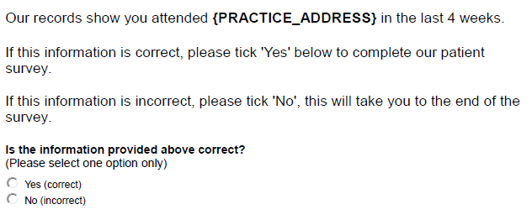
Appendix (1) – screening questions
Note: where the question states {practice_address} this information is seeded in from the records that we hold from dental practices.

Slide 15
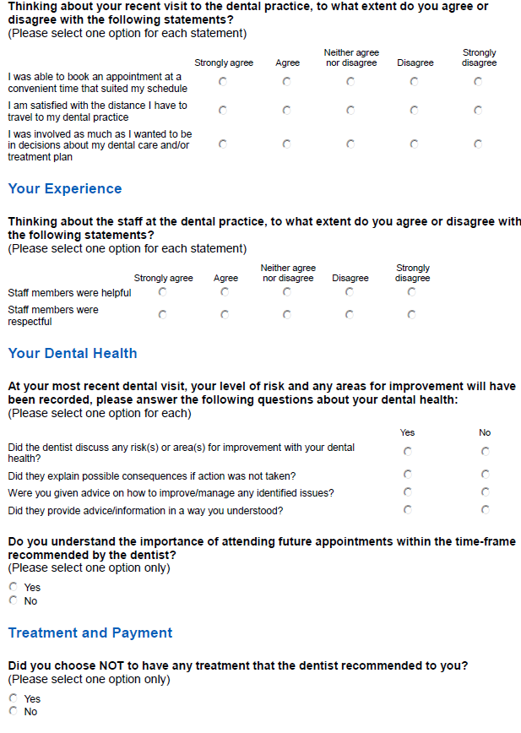
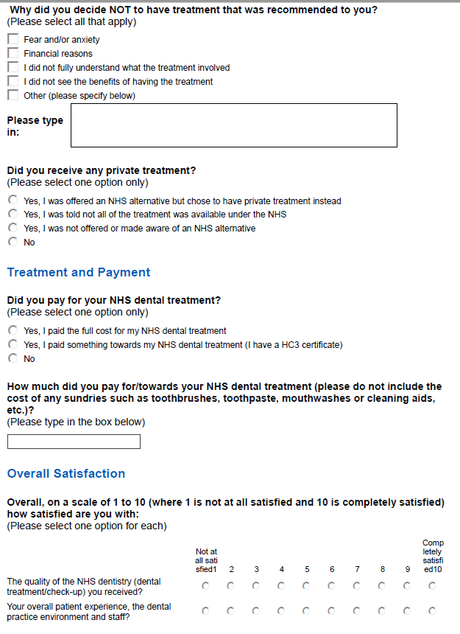
Appendix (2) – survey questions

Slide 16



www.nhsbsa.nhs.uk
@NHSBSA
NHS Business Services Authority
Notes:
The end slide can be used for a closing message, such as ‘Any questions?’.

