Slide 1



NHS Dental Services
Wales urgent patient survey results
April 2022 – March 2023

Slide 2


Introduction
The Welsh Urgent Dental Patient Survey contains 19 questions designed to measure patients’ experiences at their dental practice after requiring urgent dental treatment in Wales over the last six weeks. Demographic questions are also available.
Between 1 April 2022 and 31 March 2023, the survey collected 5,619 responses overall.
This report compares patient experiences between those who attended a dental practice under contract reform or UDA contract.
Percentages in this report are rounded and may not add up to 100%.
Statistical tests were carried out on the data. Reference to statistical significance indicates that we are confident at a 95% level that the differences between the two contracts are actual and not as a result of chance.

Slide 3

Booking your appointment – overall method
Overall, the most common method of booking an urgent dental appointment was attending or contacting a dental practice directly.
Overall, the least common method of booking an urgent dental appointment was being referred by A&E.
Other methods of booking included contacting the following: Charlie Lloyd Uber innovation fund scheme, Talking Teeth, Welsh Dental Helpline, Health Board.
Contract Reform Base size: 4447
UDA Base size: 1018

Slide 4

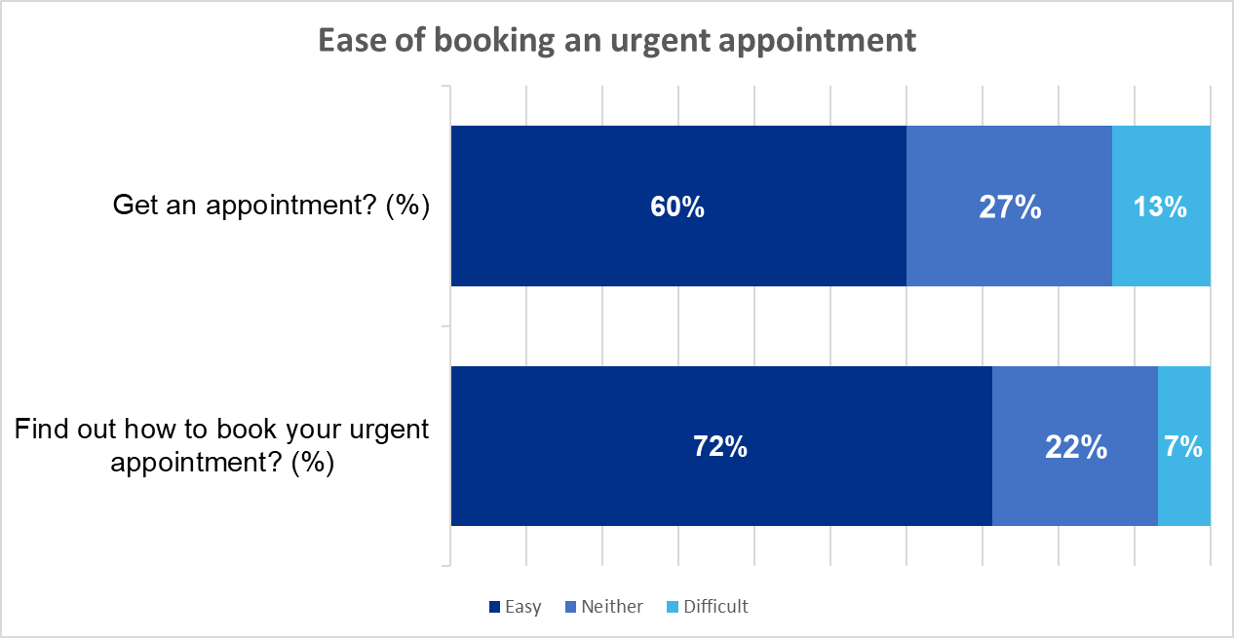
Booking your appointment
Overall, 60% of patients reported finding it extremely or very easy to get an urgent dental appointment.
Statistically significantly more patients in practices under contract reform reported finding it extremely or very easy to get an urgent appointment, than those in UDA practices.

Slide 5
Booking your appointment
Overall, 72% of patients reported that finding out how to book an urgent dental appointment was easy.
There was a statistically significant difference found, with more patients in practices under contract reform reported finding it easy to find out how to book an urgent appointment.

Slide 6
Waiting times
76% of patients in dental practices with a UDA contract were seen in two days or sooner. However, statistically significantly fewer patients (65%) in dental practices under contract reform were seen with in this time period.

Slide 7
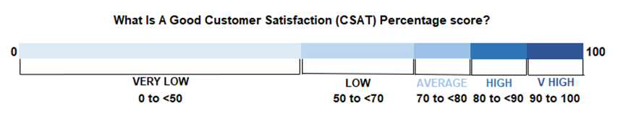
Satisfaction – waiting times
Overall, 80% of patients reported that they were satisfied with the wait between booking their appointment and seeing the dentist.
A score of 80% is classed as high customer satisfaction.​
Satisfaction is calculated in line with the NHSBSA reporting practices, where scores of 7 or above are classed as being 'satisfied' and positive indicators.
There was a statistically significant difference found, where a higher percentage of patients in practices with a UDA contract reported being satisfied than those in practices with under contract reform.
80%
satisfied
Base size: 5,455
UDA Contract
Contract Reform
83%
80%
satisfied
satisfied
Base size: 1,010
Base size: 4,445

Slide 8
Reasons for needing dental treatment
The most common reasons for attending urgent dental care included: toothache, broken filling, trauma and/or abscesses.
The least common reasons included: mouth ulcer and/or broken veneers.
Other reasons included: loose teeth, salivary gland issues, root issues and gum infections.
Base: 5619. Multiple choice answers

Slide 9
Outcomes and follow-ups
Overall, 79% of patients stated that their urgent dental problem was resolved after their appointment.
There was no statistically significant differences between outcomes reported by patients in either practice type.
Base size: 5,432​
UDA Contract
Contract Reform
Base size: 1,006
Base size: 4,426

Slide 10
Quality of NHS dentistry
86%
Overall, 86% of patients were satisfied with the quality of urgent dental care that they received.
A score of 86% is classed as high customer satisfaction.​
There was no difference found in the percentage of respondents who were satisfied with the quality of NHS dentistry between practice types.
satisfied
Base size: 5,455
UDA Contract
Contract Reform
86%
86%
satisfied
satisfied
Base size: 1,010
Base size: 4,445

Slide 11
Overall satisfaction – patient experience
89%
Overall, 89% of patients were satisfied with the urgent dental care that they received, including the dental practice environment and staff.
A score of 89% is classed as high customer satisfaction.​
There were no statistically significant differences in satisfaction ratings between contract types.
satisfied
Base size: 5,455
UDA Contract
Contract Reform
90%
89%
satisfied
satisfied
Base size: 1,010
Base size: 4,445

Slide 12


Any questions

