Slide 1
NHSBSA Dental Services
Wales Patient Survey: Urgent Dental Contracts
April 2023 – March 2024
Notes:
This layout can be used for presentations with longer titles that are too long to be boxed.

Slide 2
Introduction
The Welsh Urgent Dental Patient Survey contains questions designed to measure patient's experiences at their dental practice, as well as demographic questions about patients' personal characteristics. The same questions were asked in 2023/2024 as in 2022/2023 so direct comparisons can be made. Questions are available at the end of the report.​
The survey is distributed on a weekly basis via email and SMS text message to patients who have received dental treatment at a point in the previous six weeks in Wales. On average it was sent to 430 patients a week with an average response rate of 21% (92 responses a week).
This report compares patient experiences between those who attended a dental practice under Contract Reform or Units of Dental Activity (UDA) Contract as well as 2023/2024 against 2022/2023 where it provided useful insight.​
Between 1 April 2023 and 31 March 2024 a total of 4,787 patients started the survey. Responses from contracts that could not be determined as either being Reform or UDA were excluded in this report. As were patients who indicated on the first question that the information regarding the dental practice they visited was incorrect, they were automatically routed to the end of the survey and completed no further questions. This leaves a final base size of 4,579 valid patient responses.​
Base sizes may differ from this number throughout the report as questions are optional. ​
Percentages in this report have been rounded and so in some cases the percentage will not add up to exactly 100%. ​
Where reference is made to statistical significance, this indicates that we are confident at a 95% level that the differences between the two contracts and/or years are actual and not because of chance.​
On the charts the 2023/24 year is referred to as 2024 and 2022/23 year is referred to as 2023.

Slide 3
Booking your appointment – Overall
For 2024, patients under Contract Reform are statistically significantly more likely to attend/contact a dental practice to book their appointment (67%) than those under UDA Contracts (44%).
For 2024, patients under UDA Contracts are statistically significantly more likely to use NHS 111 (42%) than those under reform contracts (20%). Patients under UDA Contracts are also more likely to use Dental Advice Line for booking appointments (10%) than those under Contract Reform (6%). This is a statistically significant difference.
There has been a statistically significant decrease in 9 percentage points in those who attended/contacted a dentist to book an urgent dental appointment in 2024 (63%) compared to 2023 (72%). There has been a statistically significant increase overall in using NHS 111 to book appointments in 2024 (24%) compared to 2023 (16%).
‘Other’ includes referrals by GPs, A&E, local out of hours and Primary Care Dental Service Teams.

Slide 4
Booking your appointment – Focus on 2024 (2023/24)
Attending or contacting a dentist directly and NHS 111 are the most common methods for booking urgent appointments, followed by Dental Advice Line.
A statistically significant higher number of patients attend/contact a dental practice to book their urgent appointment under Contract Reform (67%) compared to UDA Contract (44%).
A statistically significantly higher number of patients booked their urgent appointment through NHS 111 under the UDA Contract (42%) compared to only 20% under Contract Reform.
A statistically significantly higher number of patients booked their appointment through the dental advice line under the UDA Contracts (10%), compared to Contract Reform (6%).

Slide 5
Ease of booking your appointment
Ease is calculated in line with the NHSBSA reporting practices. A percentage of ‘Ease’ is calculated by adding ‘extremely easy’ and ‘very easy’ ratings out of all responses to the question to give an ease rating.
There has been a statistically significant decrease of three percentage points in the number of patients who found it ‘extremely/very easy’ to get an appointment under Contract Reform in 2024 (59%) when compared to 2023 (62%).
No statistically significant differences were found for UDA Contract when comparing 2023 (54%) to 2024 (58%).
No statistically significant differences were found in how easy it was to get a dental appointment for UDA Contract 2024 (58%) and Contract Reform 2024 (59%).
No statistically significant differences were found overall from 2023 (60%) to 2024 (58%).

Slide 6
Ease of finding out ‘how’ to book your urgent appointment
There has been a statistically significant decrease of 4 percentage points overall in the number of patients who found it ‘extremely/very easy’ to find out how to book their urgent appointment in 2024 (68%) compared to 2023 (72%).
No statistically significant differences were found for UDA Contract when comparing 2023 (63%) to 2024 (64%).
There has been a statistically significant decrease of 5 percentage points in in ease of finding how to book urgent appointments under Contract Reform in 2024 (69%) compared to 2023 (74%).
In 2024, those under Contract Reform found it statistically significantly easier to find out how to book their urgent appointment (69%) compared to patients under UDA Contract (64%).

Slide 7
Waiting Times
For patients seen in less than 24 hours, overall there has been a statistically significant decrease by 2 percentage points in 2024 (41%) compared to 2023 (43%). For UDA Contract there has been a statistically significant decrease by 9 percentage points from 2023 (46%) compared to 2024 (37%). No statistically significant differences were found for Contract Reform.
Five percent more patients were seen under Contract Reform in less than 24 hours (42%) compared to UDA Contract (37%) in 2024.
There has been a statistically significant increase overall in patients seen within 1 to 2 days in 2024 (27%) compared to 2023 (23%), 3% more patients were seen with 1 to 2 days under Contract Reform in 2024 (25%) compared to 2023 (22%). For UDA Contract, 6% more were seen within 1 to 2 days when comparing 2024 (36%) to 2023 (30%).
For 2024, 36% of patients are seen within 1 to 2 days under UDA Contract compared to 25% for Contract Reform. This was a statistically significant difference.

Slide 8
Satisfaction – Waiting Time
Satisfaction is calculated in line with the NHSBSA reporting practices, a scale of 1-10 is used and scores of 7 or above are classed as being 'satisfied’. A percentage is calculated of those scoring 7 or above, out of all responses to the question, to give a satisfied percent.
Satisfaction with the waiting time between booking appointment and seeing the dentist has statistically significantly decreased by 4 percentage points for UDA Contract in 2024 (79%) when compared to 2023 (83%).
No statistically significant differences were found in satisfaction when comparing Contract Reform 2024 (79%) and UDA Contract 2024 (79%).
No statistically significant differences in satisfaction were found for combined or Contract Reform when comparing 2024 to 2023.

Slide 9
Reasons for attending urgent dental care 2024 (2023/2024)
Consistent with 2023, toothache, broken fillings, trauma to/broken teeth, and abscess and/or swelling remain the top 4 reasons for attending urgent dental care, with 21% to 36% of respondents selecting these options.
This is a multiple choice question, patients can select more than one option.
Other specified reasons included infection, extractions, nerve and jaw pain, and issues with gums and sockets.

Slide 10
Outcome and Follow up
Overall, 77% of patients said their problem was resolved after their appointment, this is statistically significantly lower by two percentage points when compared to 79% of patients in 2023.
No statistically significant differences were found in patients reporting their problem had been resolved between Contract Reform 2024 (77%) and UDA Contract 2024 (77%).
In 2023, 80% of patients under Contract Reform reported their problem was resolved, there has been a statistically significant decrease by 3 percentage points in 2024 (77%).
No statistically significant differences were found for UDA Contract from 2023 to 2024.

Slide 11
Satisfaction with Quality of Dentistry
Satisfaction with the quality of NHS dentistry has statistically significantly decreased by two percentage points for combined in 2024 (84%) compared to 2023 (86%).
No statistically significant differences were found for satisfaction with the quality of NHS dentistry between Contract Reform 2024 (84%) and UDA Contract 2024 (84%).
Satisfaction has statistically significantly decreased by two percentage points for Contract Reform for 2024 (84%) when compared to 2023 (86%). No statistically significant differences in satisfaction were found for UDA Contract from 2023 to 2024.

Slide 12
Overall Satisfaction with Patient Experience
Overall satisfaction for patient experience has decreased statistically significantly by one percentage point for combined for 2024 (88%) compared to 2023 (89%).
No statistically significant differences were found in overall patient experience between Contract Reform 2024 (88%) and UDA Contract 2024 (88%).
Satisfaction has statistically significantly decreased by one percentage point for Contract Reform for 2024 (88%) when compared to 2023 (89%). No statistically significant differences in satisfaction were found for UDA Contract from 2023 to 2024.
Dark blue is 2024
Light blue is 2023

Slide 13
Summary: Combined Contracts
When combining the two contracts together, there are statistically significant differences between data collected in the 2023/24 period (2024) and the 2022/23 period (2023).
Areas where there has been a statistically significant increase in 2024 compared to 2023:
  More patients used NHS 111 to book their appointment (24% up from 16%)
  Increase in number of patients reporting they were seen in 1 to 2 days (27% up from 23%)
Areas where there has been a statistically significant decrease in 2024 compared to 2023:
  Fewer patients attended/contacted a dental practice to book their appointment (63% down from 72%)
  Fewer patients found it extremely/very easy to find out how to book their appointment (68% down from 72%)
  Decrease in number of patients reporting they were seen in less than 24 hours (41% down from 43%)
  Fewer patients reporting their problem was fixed/resolved (77% down from 79%)
  Overall satisfaction with the quality of NHS dentistry has decreased by two percent (84% down from 86%)
  Overall satisfaction with patient experience has decreased by one percent (88% down from 89%)

Slide 14
Summary: Comparing UDA and Contract Reform 2024
When comparing UDA Contracts against Contract Reform contracts for 2024, there are statistically significant differences between data collected in the 2023/24 period (2024).
Areas where Contract Reform practices are statistically significantly higher than UDA Contract practices:
  More patients attended/contacted a dental practice to book their appointment (67%) compared to 44% for UDA
  More patients found it extremely/very easy to find out how to book their appointment (69%) compared to 64% for UDA
  Higher number of patients reporting they were seen in less than 24 hours (42%) compared to 37% for UDA
Areas where UDA Contract practices are significantly higher than Contract Reform practices:
  More patients used NHS 111 to book their appointment (42%) compared to 20% for Contract Reform
  More patients used the Dental Advice Line to book their appointment (10%) compared to 6% for Contract Reform
  Higher number of patients reporting they were seen in 1 to 2 days (36%) compared to 25% for Contract Reform

Slide 15
Summary: Contract Reform 2024 vs 2023 and UDA Contract 2024 vs 2023
The following statistically significant differences were found when comparing Contract Reform practices 2024 to 2023 and comparing UDA Contract Practices 2024 to 2023.
Contract Reform: Areas where there has been a statistically significant increase in 2024 compared to 2023
  Increase in patients seen within 1 to 2 days (25% up from 22%)
Contract Reform: Areas where there has been a statistically significant decrease in 2024 compared to 2023
  Decrease in patients who found it extremely/very easy to get an appointment (59% down from 62%)
  Decrease in patients who found it extremely/very easy to find out how to book their appointment (69% down from 74%)
  Fewer patients reporting their problem was fixed/resolved (77% down from 80%)
  Decrease in satisfaction with quality of dental treatment (84% down from 86%)
  Decrease in satisfaction with patient experience (88% down from 89%)
UDA Contract: Areas where there has been a statistically significant increase in 2024 compared to 2023
  Increase in patients seen within 1 to 2 days (36% up from 30%)
UDA Contract: Areas where there has been a statistically significant decrease in 2024 compared to 2023
  Decrease in patients reporting they were seen in less than 24 hours (37% down from 46%)
  Decrease in satisfaction with waiting time between booking appointment and seeing the dentist (79% down from 83%)

Slide 16

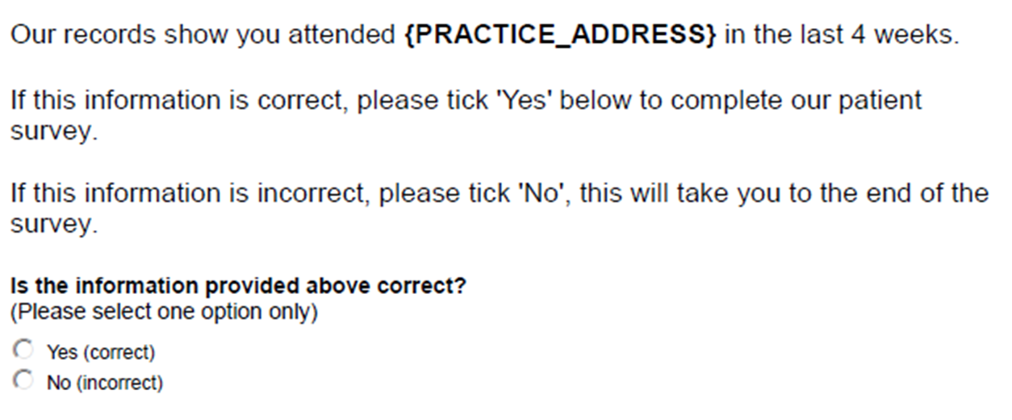
Appendix (1) – screening questions
Note: where the question states {practice_address} this information is seeded in from the records that we hold from dental practices.

Slide 17
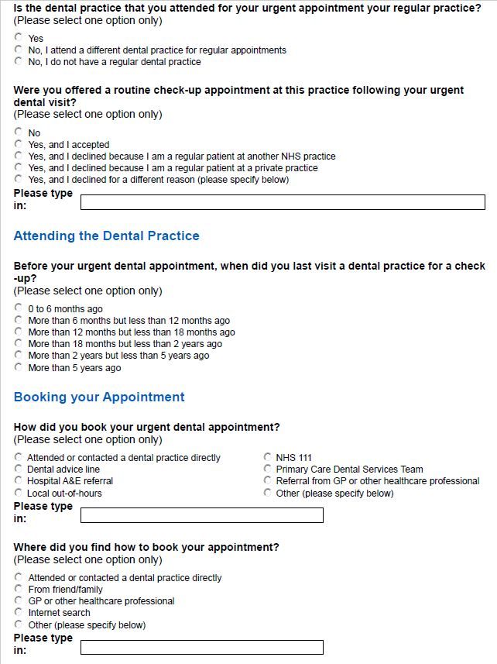
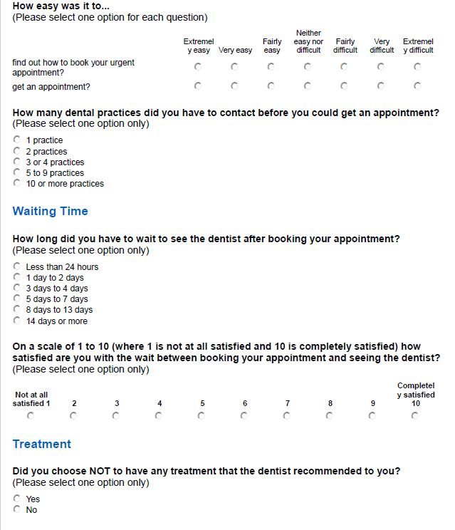
Appendix (2) – Questions

Slide 18
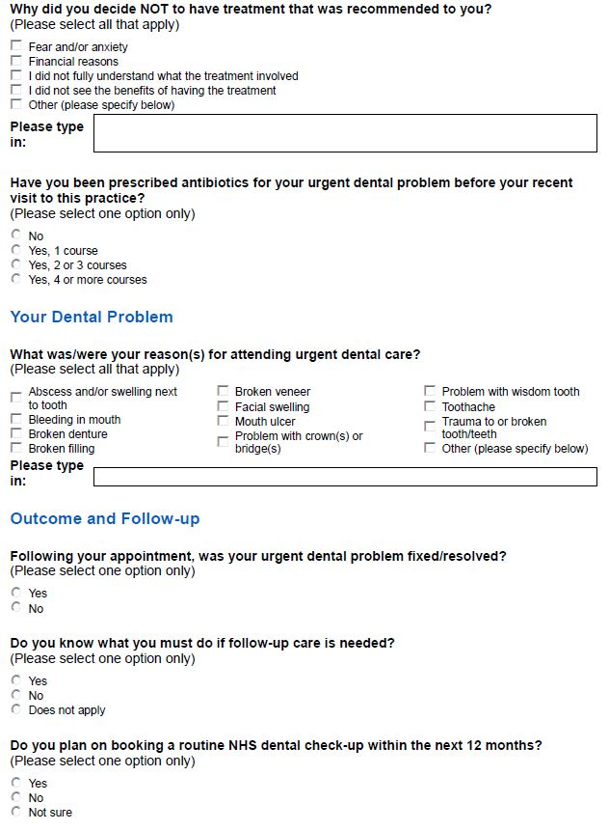
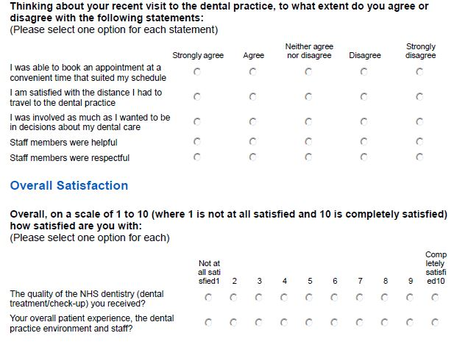
Appendix (2) – Questions

Slide 19



www.nhsbsa.nhs.uk
@NHSBSA
NHS Business Services Authority
Notes:
The end slide can be used for a closing message, such as ‘Any questions?’.

